Slide 1



BEHAVIORÁLNE FINANCIE
Jozef Glova
TUKE, Košice 2021

Slide 2
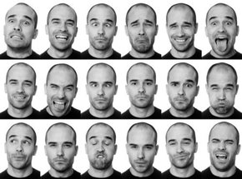

Obsah prezentácie​
Finance: Normative vs. Positive or Traditional vs. Behavioral​​
Video: Daniel Kahneman – Behavioral Finance (33 min.)​
Video: Richard Thaler on Behavioral Economics (optional)​

Slide 3
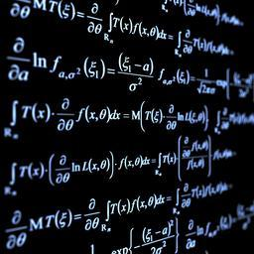

Tradičné vs. Behaviorálne financie​​
​
Traditional finance
Behavioral finance
Normative approach describing how real world should function
Not able to explain real world interactions
Homo economicus, rationality
Continuous dynamic optimization, equilibrium
Efficient market hypothesis, Modern portfolio theory, mean-variance analysis (expected returns, volatility of returns), CAPM
Positive approach describing how real world is functioning
Based on academic research in cognitive psychology
(Rational) irrationality
Emotions, optimism, pessimism, greed and fear dominates all decision-making (under risk, i.e. in real life)
Prospect theory (Kahneman, Tversky – 1979), cornerstone of behavioral finance, behavioral biases leading to suboptimal decision-making

Slide 4
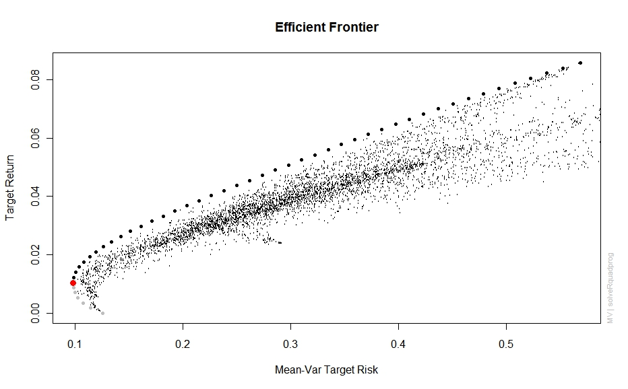
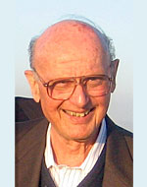
Normatívny prístup – Teória portfólia 1/2​
Markowitz Harry M. Portfolio Selection, Journal of Finance 7, No. 1, pp. 77-91, March1952.

Slide 5
Normatívny prístup – Teória portfólia 2/2​
Expected Rate of Return
IC₃
IC₂
Efficient Frontiers
IC₁
Optimal portfolio with preferences described based on indifference curves
Expected Rate of Return
R
X
Portfolio with min. variance with a specific return R
Global min. variance portfolio
Standard Deviation
Standard Deviation

Slide 6
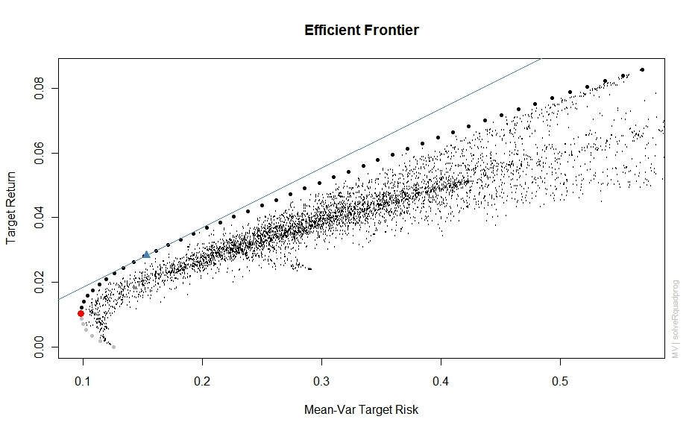
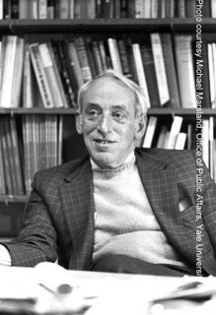
Tobinové rozšírenie efektívnej hranice​
James Tobin: Liquidity Preference as Behavior Towards Risk, Review of Economic Studies 26, č. 1, 1958.

Slide 7
Vzťah riziko vs. výnos​

Slide 8





Capital Asset Pricing Model (CAPM)​​​​
​
Capital market theory is based on the portfolio theory (M-V model) and it is the extension for pricing of all capital assets. The result is the capital asset pricing model (CAPM), the model used to determine a theoretically appropriate required rate of return of an asset, to make decisions about picking assets to a well-diversified portfolio. ​

Slide 9
Predpoklady CAPM​
Capital markets are perfect and efficient where there is free flow of information and no transaction costs.​
There are no personal and corporate taxes.​
All investors are single period wealth maximizes.​
Investors have homogeneous or similar expectations about risks and returns of a security.​
All investors can borrow and tend at the risk free rate which is assumed to remain constant.​
There is no inflation in the economy.​
Investors are risk averse.​
There is normal distribution of returns of a given security and that there exists a well diversified market portfolio without unsystematic risk.​
I think that the most awkward one is homogeneous expectations. All price movements are assumed to be the result of a change in expectations, yet people often buy and sell shares because they disagree with the price not because they have new information. Financial market prices change far more frequently than the fundamentals which is what one would expect from the process of disagreement. This mixture of information and disagreement unfortunately lies between the traditional CAPM analysis and behavioural approaches, between two opposing camps of academics, so there is little hope of development.​

Slide 10
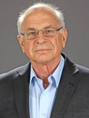

Prospect Theory (Kahneman, Tversky – 1979)​
Fast and successful development of behavioral finance (economics) from 1970s​
Daniel Kahneman and Amos Tverky (academic psychologists) – The most famous paper Prospect Theory: An Analysis of Decision under Risk – Econometrica, 1979​
Prospect theory is cornerstone of behavioral finance, behavioral economics overall – Descriptive alternative to mainstream expected utility theory​
Framing – Form versus substance, risk-seeking versus risk-aversion depending on losses or gains​
In 2002, Kahneman received the Nobel Memorial Prize in Economics, despite being a research psychologist, for his work in prospect theory, decision making and judgment under risk, i.e. in real world conditions. (Amos Tversky prem. died in 1996)​
Daniel Kahneman (1934)​
Amos Tversky (1937-1996)​

Slide 11
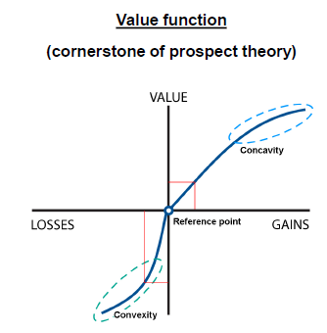
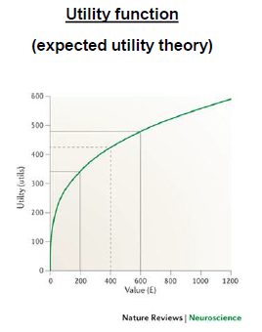
Prospect Theory vs. Utility Theory​
Relative values (changes) matter, not absolute values​
Concave in gains, convex in losses​
⇒ Risk-seeking in losses, risk-aversion in gains​
Losses are felt 2 –2.5 times more than gains of the same magnitude​
Absolute values matter, not relative changes (in wealth)​
General risk-aversion due to concavity​
⇒ Sure options preference in general​
Gains and losses are felt in the same way (magnitude)​

Slide 12

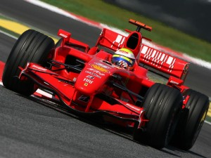
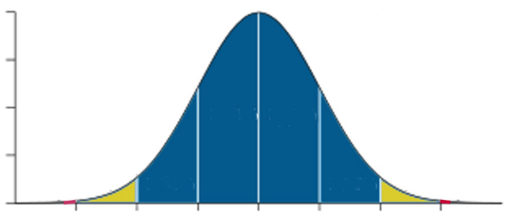
Overoptimism bias​​​
​
What does it mean?
Everybody wears „pink glasses“
Real life example
80% of drivers rate themselves as above-average
Investing
„My investment performance will be ca 25% every year“
How to make better decisions?
Think in terms of „probability distributions“
DCF, Capital projects analysis – Be very conservative

Slide 13
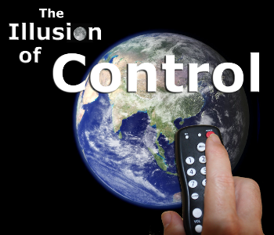
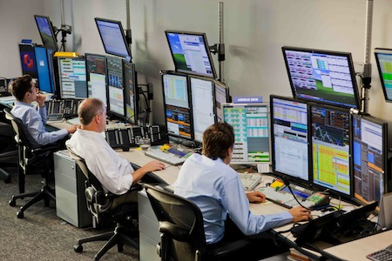
Overoptimism bias​​​
​
What does it mean?
People think they can control random and / or uncontrollable events
Real life example
Taleb (Fooled by Randomness, 2001) – The real world is much more unpredictable than we think. People interpret reality in such a way that they form stories that puts well to each other.
Investing
„Internet and online trading (marketing campaigns tell us that it will improve our performance) – Various tools should improve our analytical skills and performance (Barber, Odean) ⇒ Speculative investments, well too much trading (overconfidence, overoptimism)​

Slide 14
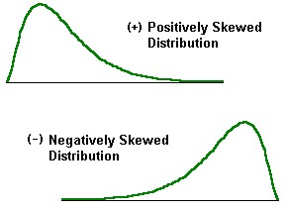

Illusion of control bias (2)
How to make better decisions?
Realize that „Investing is a probability activity“; World is much more complex and uncertain than you think
Business strategy / capital projects / DCF ⇒ Pay much more attention to risk analysis / sensitivity and scenarios analysis, stress testing, and do not bases your investment decision only on simple DCF / NPV analysis

Slide 15
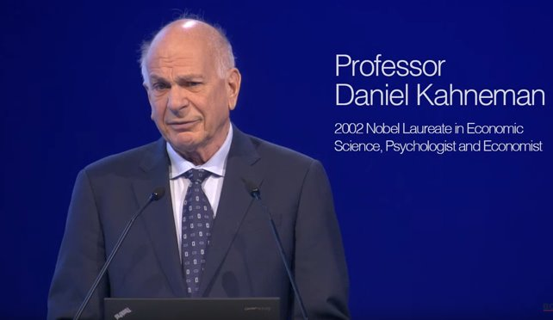

Vertikálna analýza​​​​
​

Slide 16
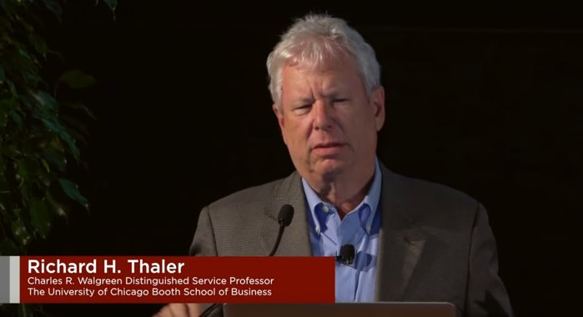
Behavioral Economics: Past, Present, and Future by Prof. Richard Thaler​​​​
​

Slide 17
Použitá a odporúčaná literatúra​
​
[1.] Baláž, V. (2009). Riziko a neistota. Úvod do behaviorálnej ekonómie a financií. VEDA: Bratislava. ISBN 978-80-224-1082-3. ​
​[2.] CFI (2021). Behavioral Finance. How processing errors and biases impact investors. Dostupné na: https://corporatefinanceinstitute.com/resources/knowledge/trading-investing/behavioral-finance (18.10.2021)​
​[3.] 10 examples of behavioural finance. Dostupné na: https://hrdisruptors.com/10-examples-of-behavioural-finance/ ( dňa 16.10.2021) ​
​

Slide 18
ĎAKUJEM ZA POZORNOSŤ!​
OTÁZKY?

