Slide 1
How to build a good name and logo for a brand or company? Rules. Mistakes examples.
implementation as part of the project NICE (Network for Inter-Institutional Cooperation in Entrepreneurial Education) financed by the EU Erasmus+ program

Slide 2
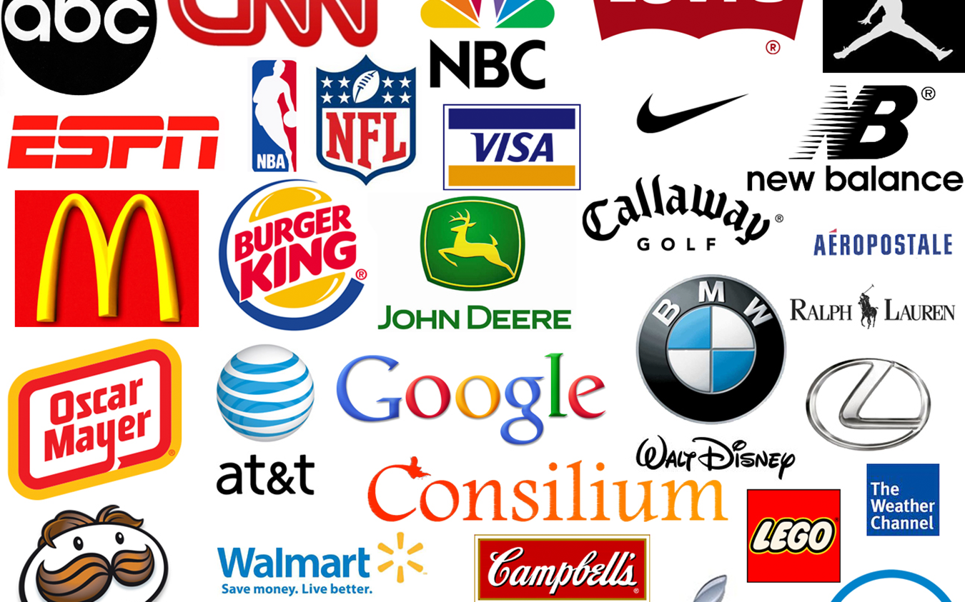

Slide 3
Presentation plan:
What is a brand?
Basic brand functions.
Brand name.
Features of a good brand name.
Logotype (brand mark).
Features of a good logo (brand mark).
Examples.
Exercise 1
Exercise 2.
Bibliography.

Slide 4
What is a brand?
The brand is:
name, concept, graphic sign, symbol, drawing, color, melody or combination of these elements, created to mark a product or service and to distinguish it favorably from the competition's offer [Ph. Kotler, G. Armstrong].

Slide 5
Basic brand functions:
The basic functions of the brand include:
information function - the brand, by including a simple, easily readable message in its name and logo, provides recipients with information about the product, its use, purpose and properties,
identification function - thanks to the configuration of various brand elements, it is easier to notice and distinguish, and thus speeds up finding the product you are looking for,
warranty function - the brand ensures constant quality regardless of the place and time of purchase, reduces the risk of purchase, simplifies the decision-making process,

Slide 6
promotional function - the brand attracts consumers' attention, persuades them to buy, and can confirm the consumer's image,
transformational function - the brand image may influence the perception of the physical side of the product, awareness of the brand used provides psychological satisfaction.
A company name may constitute a brand name if it is used to designate products/services that the company offers on the market (e.g. Sony). However, the company may use separate markings for its products (in addition to its name, Sony has promoted, for example, the PlayStation brand - consoles, games).

Slide 7
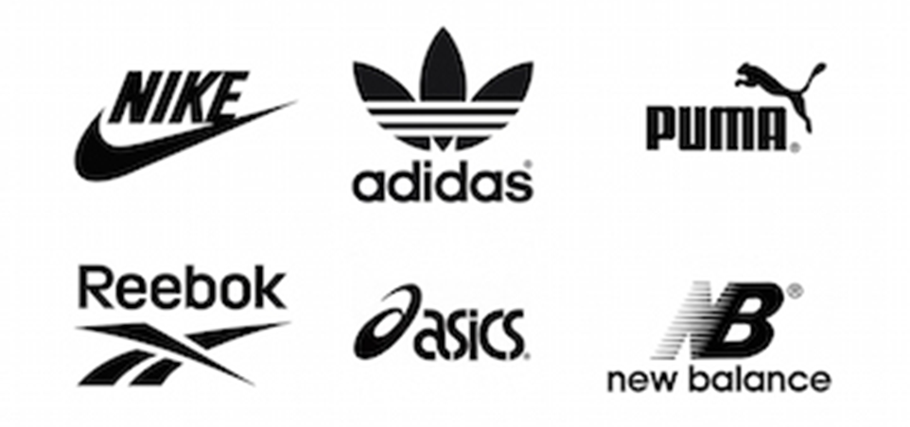
Brand Name:
A brand name is a term (verbal expression) with which a brand is identified.

Slide 8
Features of a good brand name:
Brand Name:
It should be unique/distinctive (e.g. Reebok, Mustang).
It should give an idea of ​​the properties and advantages of the product (e.g. Quickfix, Lipguard, Audi - Latin: audi - listen).
It should be easy to pronounce, identify and remember (e.g. Nike, Coca-Cola).
It should be easily convertible into foreign languages (e.g. BP - previously British Petroleum (the name was shortened), H&M, BMW - German Bayerische Motoren Werke).
It should be able to be legally protected and registered.

Slide 9
It should suggest the product/service category (e.g. Newsweek, iPhone).
It should indicate specific features (e.g. Firebird, Trends).
It should not represent bad/erroneous meanings in other categories (e.g. Rolls Royce Silver Mist – mist = "mist" (English) or "dung" (German).
It should be possible to maintain throughout the entire life cycle of the product and the company (e.g. the original name of 3M - Minnesota Mining and Manufacturing Company - described the company's activities too precisely, due to changes in the company's area of operation - today: the concern produces over 55,000 products, including plastics, abrasives, electronics and pharmaceutical industries, was changed to 3M).

Slide 10
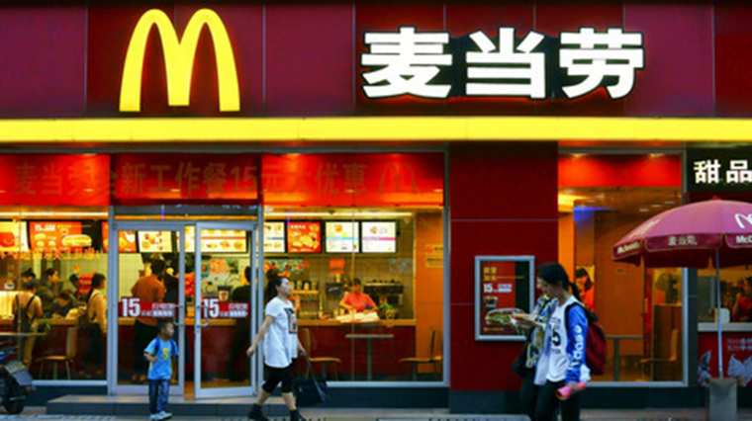
Logotype (brand mark):
A brand logo/mark is a part of a brand that can be recognized but is not expressed in words. It can be a form, a shape, a particular color, etc./
Because it is much easier for consumers to remember symbols (images) than names (words), symbols are much more universal than words.
Next to the McDonald's restaurant in China/

Slide 11
Features of a good logo (brand mark):
Logotype / brand mark:
It should be clear in terms of meaning.
It should be pleasing to the eye.
It should be easy to see and remember.
It should be associated with the product and resemble it.
It should be easy to promote in the media.
It should not evoke negative associations, above all.
It should contain an element that distinguishes it from the competition.

Slide 12
Examples:
Evolution of the Mercedes logo:
Co oznacza logotyp Mercedesa?

Slide 13
The Mercedes-Benz brand logo is a simplification of a three-pointed star, which was originally intended to symbolize the capabilities of designed and manufactured engines in the sea, in the air and on land, i.e. the brand's dominion in these three environments.
(Daimler-Motoren-Gesellschaft (DMG), and later Daimler-Benz or Mercedes-Benz, did not originally produce only cars).

Slide 14
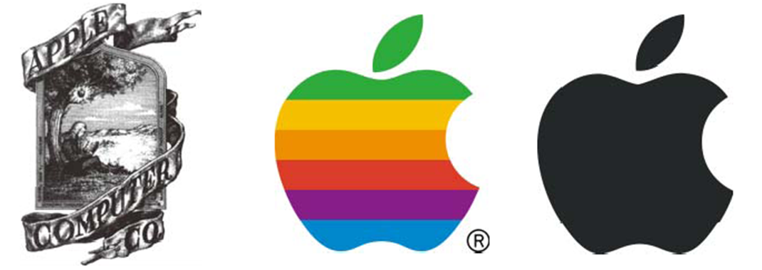
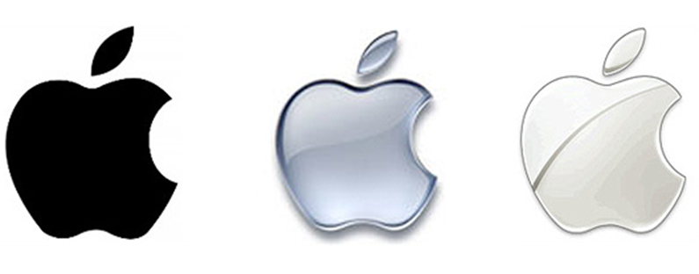
Evolution of the Apple brand logo:
The first Apple Inc. logo it was designed in 1976 by Ronald Wayne, whose design referred to Isaac Newton, who had an apple fall on his head, had an epiphany and thus discovered the law of gravity.
The scene depicted in the logo was very elaborate and decorative.

Slide 15
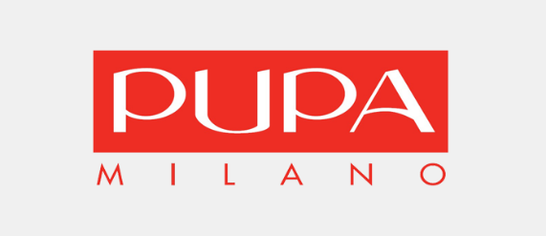
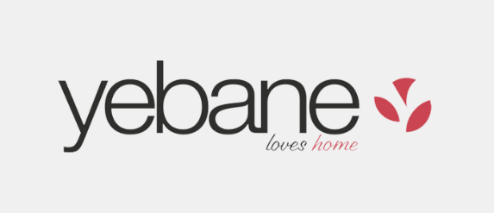
Examples of… unfortunate brand names:
OSRAM - the name was created from the combination of two words "osm" and "wolfram", in Polish it means... pooping on something/someone
SRAM - an American manufacturer of bicycle accessories, the second largest in the world after Shimano. The name comes from the names of the founders: Scott, Ray and Sam. The meaning is similar to the previous example
Yebane (Yebane Española S.A.) - a Spanish manufacturer of fabrics and curtains, in Polish ... means one of the curses.
Pupa Milano - the Italian name of cosmetics, pupa in Spanish means, among others, pupa/chrysalis, rash, scab.

Slide 16
Exercise 1:
Which of the following city logos is the best? Justify in 2-3 sentences.

Slide 17
Exercise 2:
Design a name and logo for any brand from any industry.

Slide 18
Bibliography:
Keller, K. L. (2002). Branding and brand equity. Cambridge, Mass: Marketing Science Institute.
Kotler, P., Armstrong, G. Opresnik, M. O. (2018). Principles of marketing. Harlow [etc.]: Pearson Education Limited.
Wheeler, A. (2012). Branding: a guide for brand managers. Warsaw: PWN Scientific Publishing House.
Pogorzelski, J. (2015). Brand in four ways: perceptual, emotional, social and cultural branding. Warsaw: Wolters Kluwer.

Slide 19
Thank you for your attention!

