Slide 1
INFLATION
– EFFECTS ON BUSINESSES
Dr. Leoš Šafár, MSc
TUKE, Košice 2021

Slide 2
Why do we care?
We are part of it...
Consumer staples, consumer discretionary, fuel, building material...

Slide 3
What do we examine?
The essence?
Calculation metrics?
Types of inflation?
Who and why cares?
What it is affecting?
What is the reality?

Slide 4
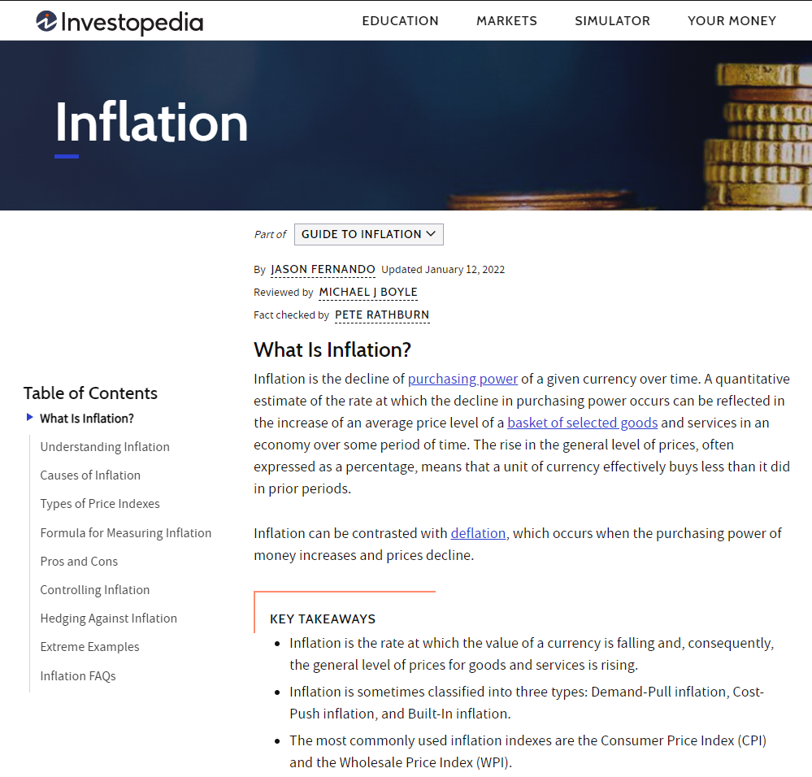
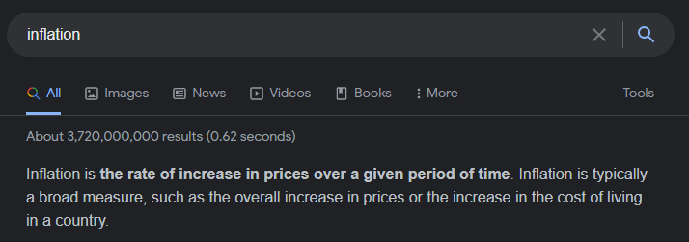
Inflation
Inflation is the decline in the purchasing power of a given currency over time.
A quantitative estimate of the extent to which purchasing power decreases may, over a period of time, translate into an increase in the average price level of a basket of selected goods and services in the economy.
The rise in the general price level, often expressed as a percentage, means that the currency unit actually buys less than in previous periods.
Inflation can be compared to deflation, which occurs when the purchasing power of money increases and prices fall.
Notes:
Google it up, or you probably know that (while movin in pictures), we are here for cherrypicking

Slide 5
Inflation indicators

Slide 6
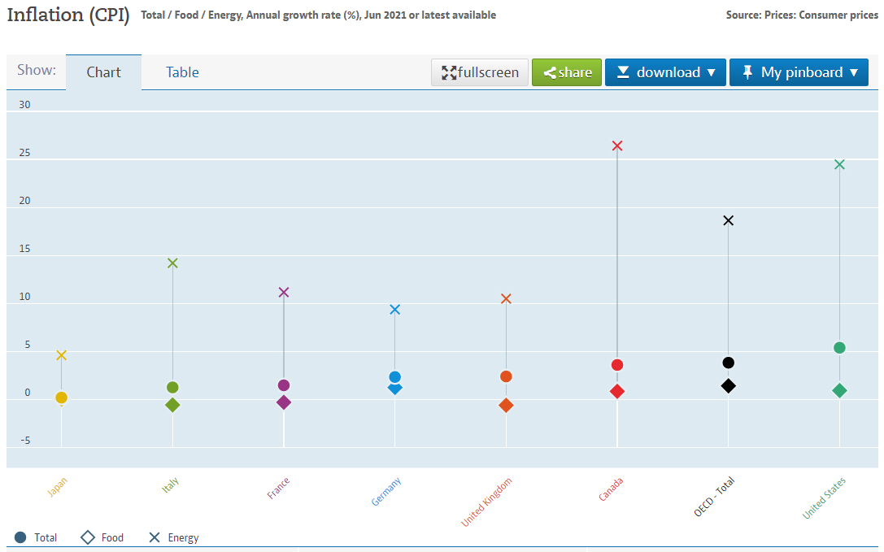
CPI – Consumer Price Index (OECD)
Headline
vs
Core
!!!
Notes:
Changing the prices of the basket of goods and services that are usually bought by specific groups of households. Inflation is measured as the annual growth rate and in the index, base year 2015, broken down into food, energy and totally excluding food and energy.
Headline vs Core !!!! – stress out the differences

Slide 7
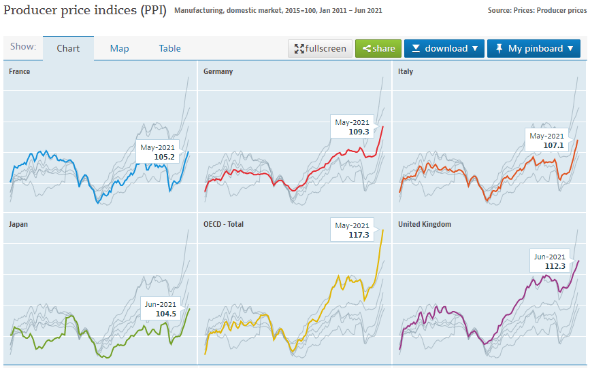
PPI – Producer Price Index(OECD)
Notes:
Producer price indices measure the rate of change in the prices of products sold as they leave the producer. They do not include any taxes, shipping and trade margins that the buyer may pay. PPIs provide indicators of the average price movements received by producers of various commodities. They are often considered as advanced indicators of price changes throughout the economy, including changes in the prices of consumer goods and services. Production includes the production of semi-finished and other intermediate products, as well as final products such as consumer goods and capital goods

Slide 8
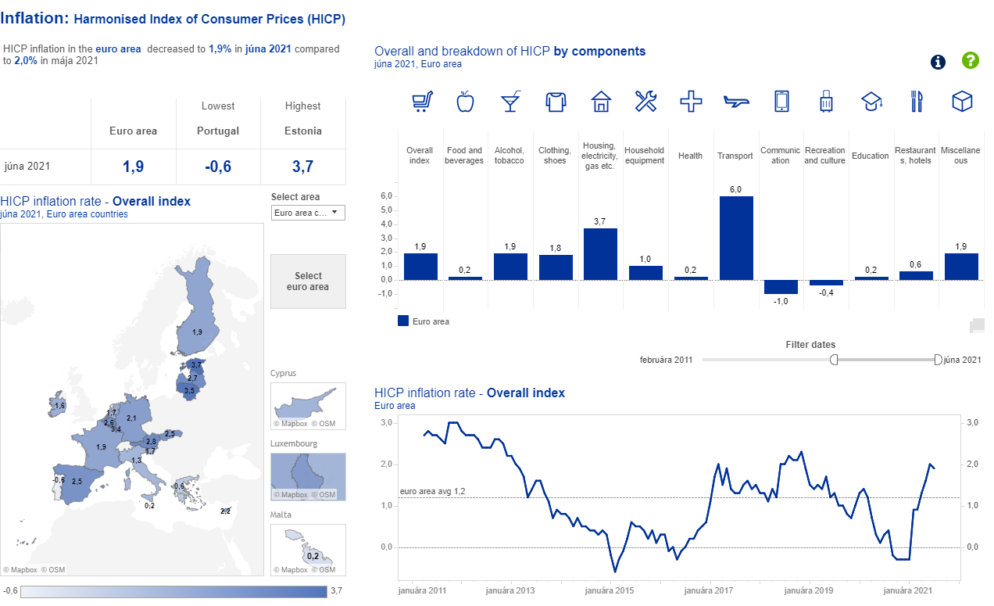
HICP – Harmonised Index of Consumer Prices (ECB)
Notes:
In the euro area, consumer price inflation is measured using the harmonized index of consumer prices (HICP). It measures the change in the time of prices of consumer goods and services obtained, used or paid by euro area households. The term "harmonized" refers to the fact that all countries of the European Union use the same methodology. This ensures that data for one country can be compared with data for another country.

Slide 9
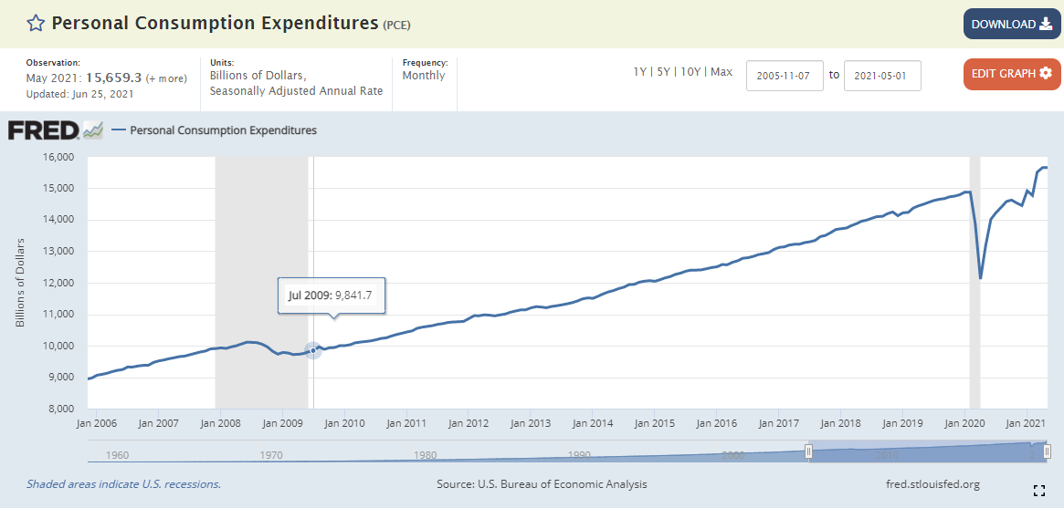
PCE – Personal Consumption Expenditures (FED)
Notes:
The term personal consumption expenditure (PCE) refers to the rate of imputed household expenditure defined over a period of time. Personal income, PCE and PCE price index readings are published monthly in the Bureau of Economic Analysis (BEA) Personal Income and Outlays. Expenditure on personal consumption supports the reporting of the PCE price index, which measures changes in the prices of consumer goods and services exchanged in the US economy. In 2012, the PCE price index became the primary inflation index used by the US Federal Reserve in monetary policy decisions.1 It is comparable to the consumer price index (CPI), which also focuses on consumer prices. Other inflation indicators that economists also monitor include the Producer Price Index (PPI) and the Gross Domestic Product (GDP) Price Index.

Slide 10
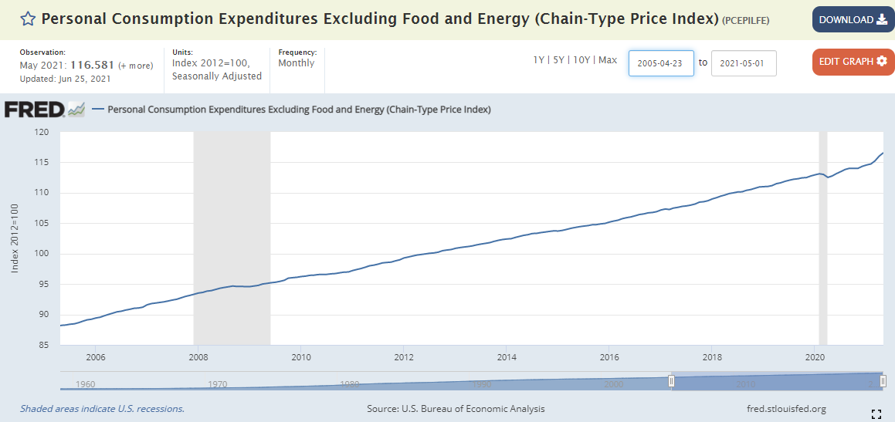
Core PCE – PCE Excluding Food and Energy (FED)
Notes:
The term personal consumption expenditure (PCE) refers to the rate of imputed household expenditure defined over a period of time. Personal income, PCE and PCE price index readings are published monthly in the Bureau of Economic Analysis (BEA) Personal Income and Outlays. Expenditure on personal consumption supports the reporting of the PCE price index, which measures changes in the prices of consumer goods and services exchanged in the US economy. In 2012, the PCE price index became the primary inflation index used by the US Federal Reserve in monetary policy decisions.1 It is comparable to the consumer price index (CPI), which also focuses on consumer prices. Other inflation indicators that economists also monitor include the Producer Price Index (PPI) and the Gross Domestic Product (GDP) Price Index.
Stress out the difference in smoothness of the curves – „CORE“ better pictured

Slide 11
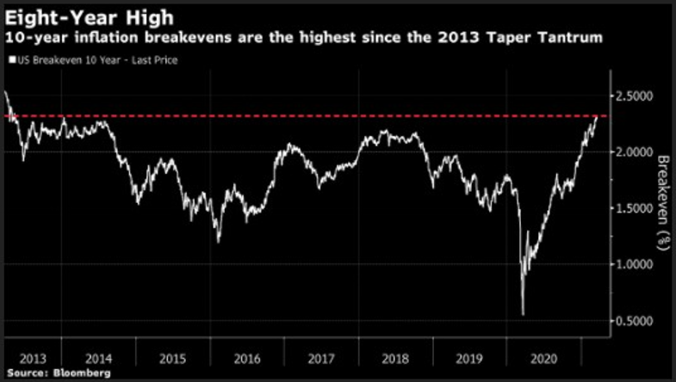
Break-even inflation
The break-even inflation rate is a market expression of expected inflation.
It is the difference between the yield on a nominal bond and an inflation-linked bond with the same maturity.
Complicated? Never mind ... Know the concept for now
Notes:
Break-even inflation is the difference between the nominal yield on a fixed-rate investment and the real yield (fixed spread) on an inflation-linked investment of similar maturity and credit quality. If inflation averages more than the break-even, the inflation-linked investment will outperform the fixed-rate. Conversely, if inflation averages below the break-even, the fixed-rate will outperform the inflation-linked.
Calculation Formula:
Comparable Fixed-Rate – Inflation-Linked Real Yield = Break-Even Inflation
Because chart like this is often used in financial industry (move in the BLMBG screen)
Calculation Example:
4.00% 5-Year CD 1.05% Inflation-Linked Real Yield 2.95% Break-Even Inflation
An inflation-linked investment’s coupon is determined by adding the current rate of inflation to the real yield. In the example above, the average rate of inflation would have to be more than 2.95% in order for the inflation-linked investment to outperform the fixed-rate investment. And if inflation averaged lower than 2.95%, the fixed-rate investment would outperform the inflation-linked.
For example, the yield on a normal bond may be high enough to beat the yield on an IPS even if there is a future increase in inflation. For example, if an IPS is priced with a 3% real yield and a normal bond is priced with a 7% nominal yield, inflation would have to average more than 4% over the life of the bond for the IPS to be a better investment. This inflation rate at which neither security is more attractive is known as the breakeven inflation rate.

Slide 12
Cause
Demand-driven – 2008 & subsequent CB policy
Cost-Pushed – here we are (bottlenecks)
„Built-in”
Notes:
Demand-driven inflation occurs when an increase in the supply of money and credit stimulates overall demand for goods and services in the economy to grow faster than the productive capacity of the economy. This increases demand and leads to higher prices. With more money available to individuals, positive consumer sentiment leads to higher spending, and this increased demand raises prices. It creates a difference between demand and supply with higher demand and less flexible supply, resulting in higher prices.
The most common cause of cost inflation begins with an increase in production costs, which may or may not be expected. For example, the cost of raw materials or stocks used in production may increase, leading to higher costs. Increased labor costs can create cost-push inflation, for example when mandatory minimum wages for production workers are raised Natural disasters, which can include floods, earthquakes, fires or tornadoes, are often unexpected causes of rising inflation. If a major disaster causes unexpected damage to production equipment and results in shutdown or partial disruption of the production chain, higher production costs are likely to follow.

Slide 13
Historical development

Slide 14
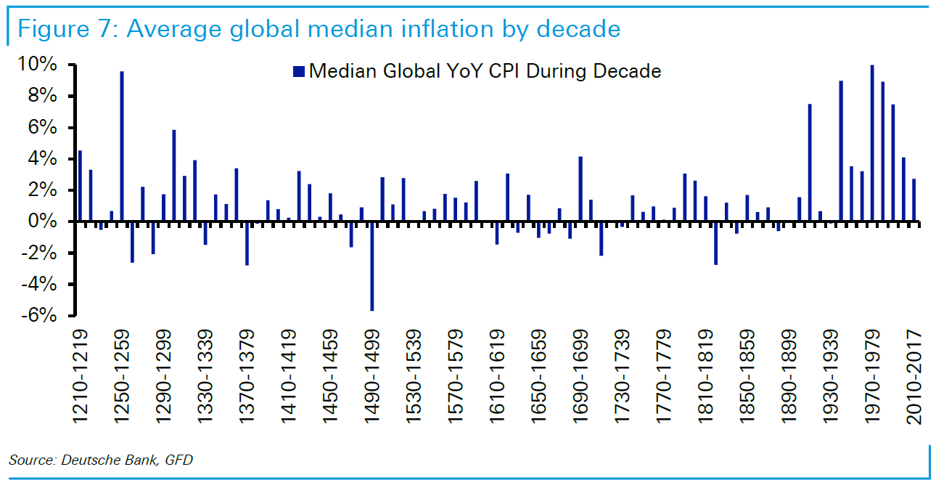
Notes:
Only last century is inflation-linked significantly on th YoY basis since 13th century

Slide 15
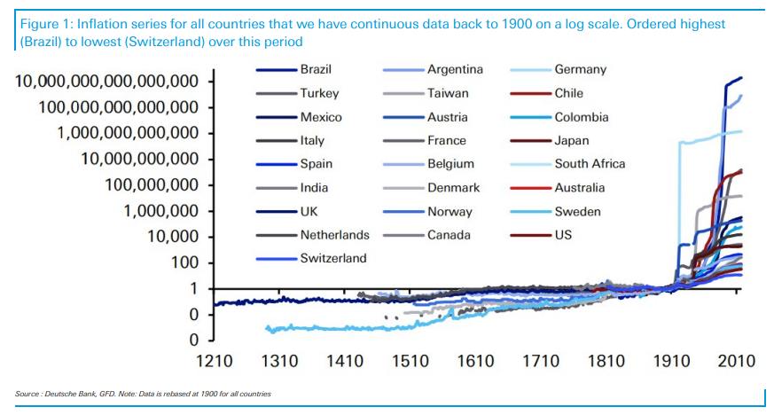
Notes:
Over the same period, Brazil scored the highest levels, while Switzerland maintained to have the lowest inflation.

Slide 16
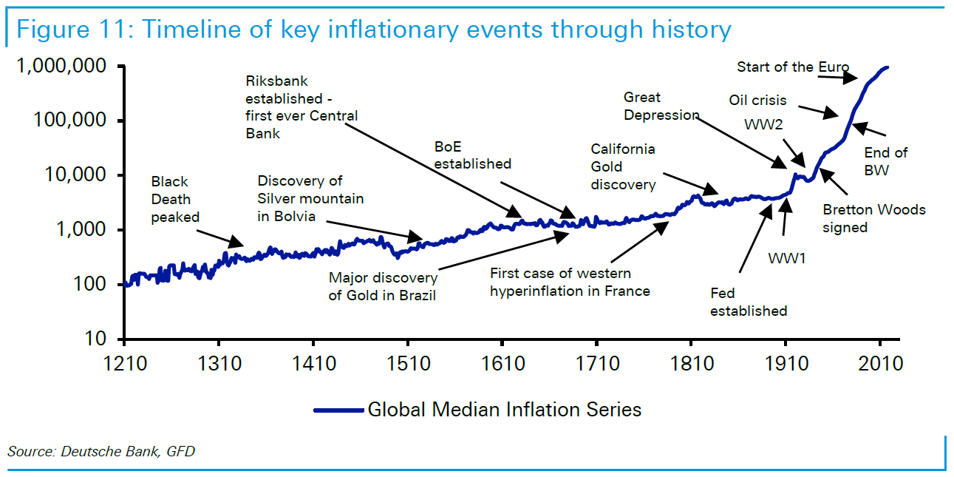
Notes:
We do not want conspiracy here, but we all see the uptick after the FED has been born

Slide 17
Actual state?
Notes:
Highest inflation in the US in last 6 decades

Slide 18
How to survive?
Future contracts
Forward contracts
Options
Pre-storage (experience & resources)
Notes:
Explain the points

Slide 19
TY
Qs?
Dr. Leoš Šafár, MSc leos.safar@tuke.sk

Slide 20
Consumer Expectations

Slide 21
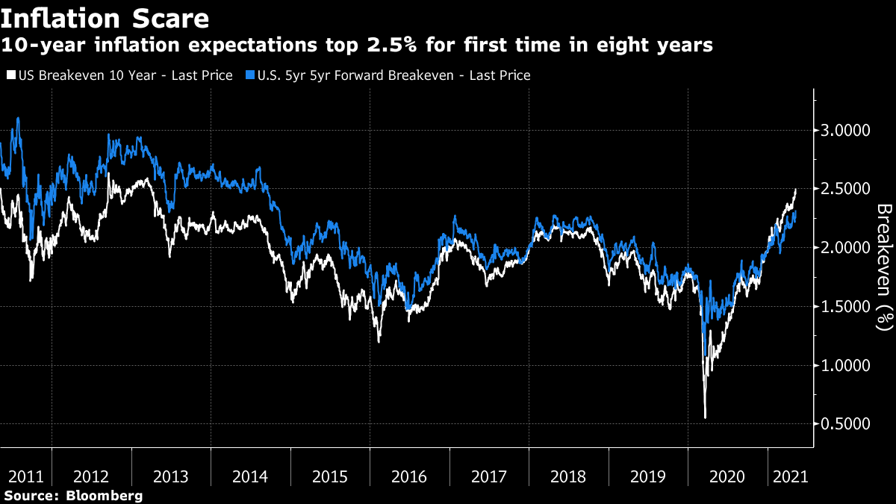

Slide 22
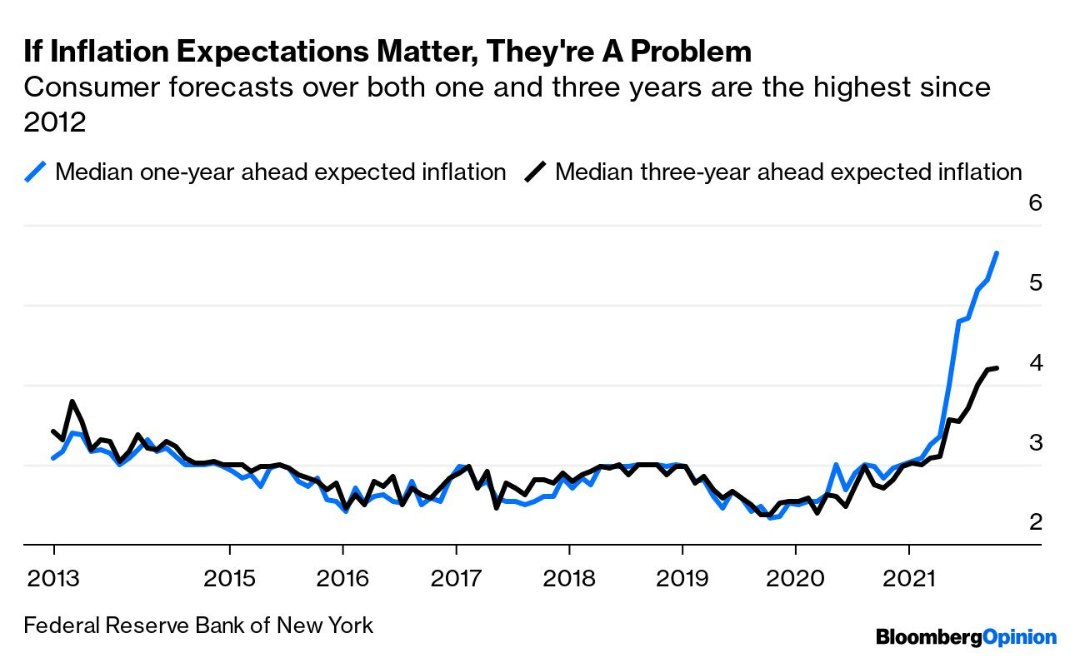

Slide 23
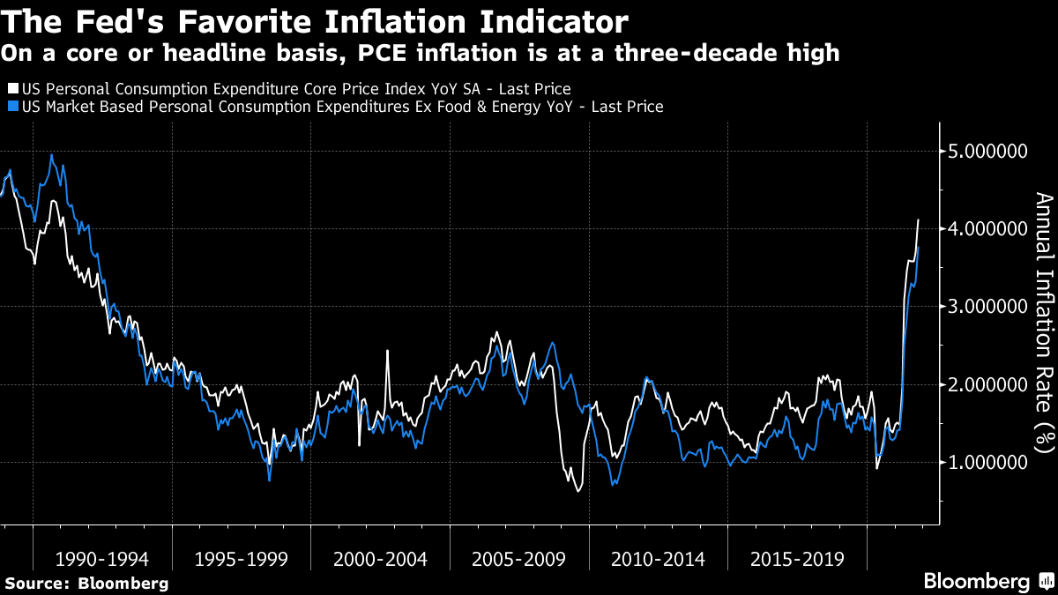

Slide 24
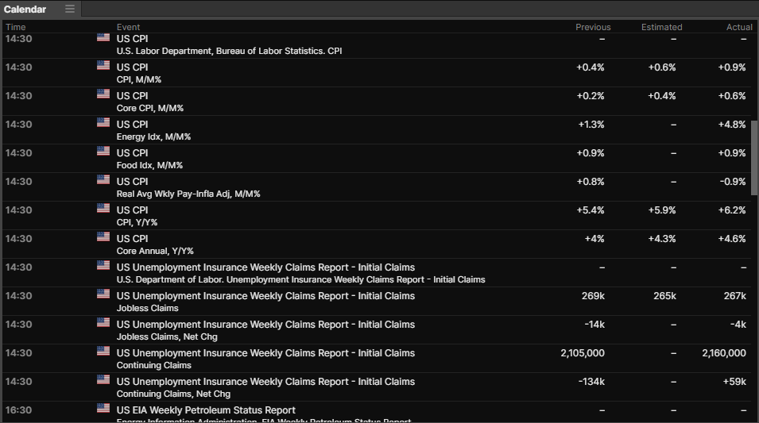
CPI reading – 10.11.2021

Slide 25
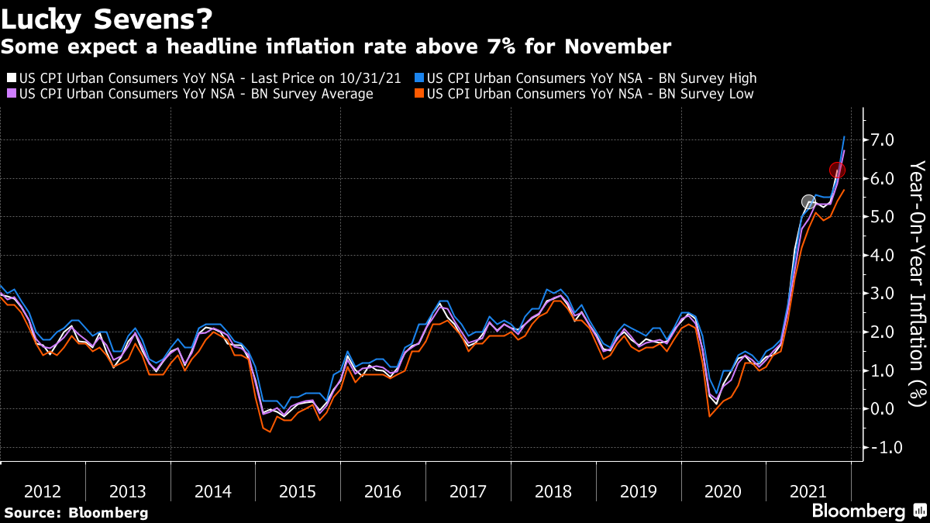
Notes:
CPI reading – 10.12.2021 6.8% - highest since 1984

Slide 26
Producers´ costs
Notes:
This turns into a margin, a profitability, a share price - hence the inv. point of view

Slide 27
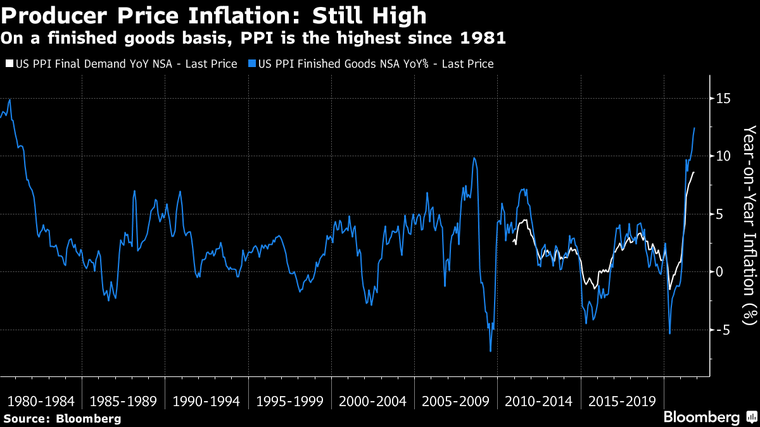

Slide 28
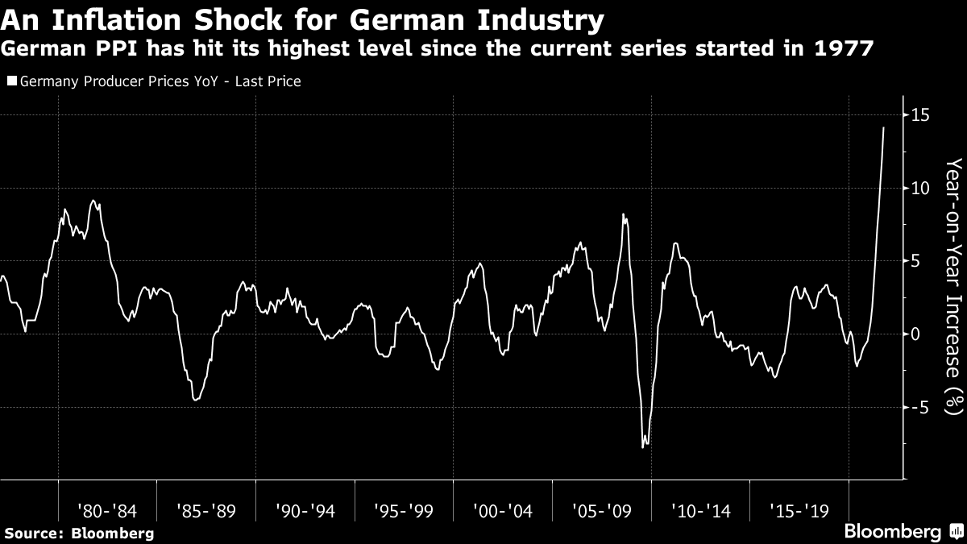

Slide 29
Yields´ view
Notes:
To sa pretaví do marže, ziskovosti, to do ceny akcií – preto inv. hľadisko

Slide 30
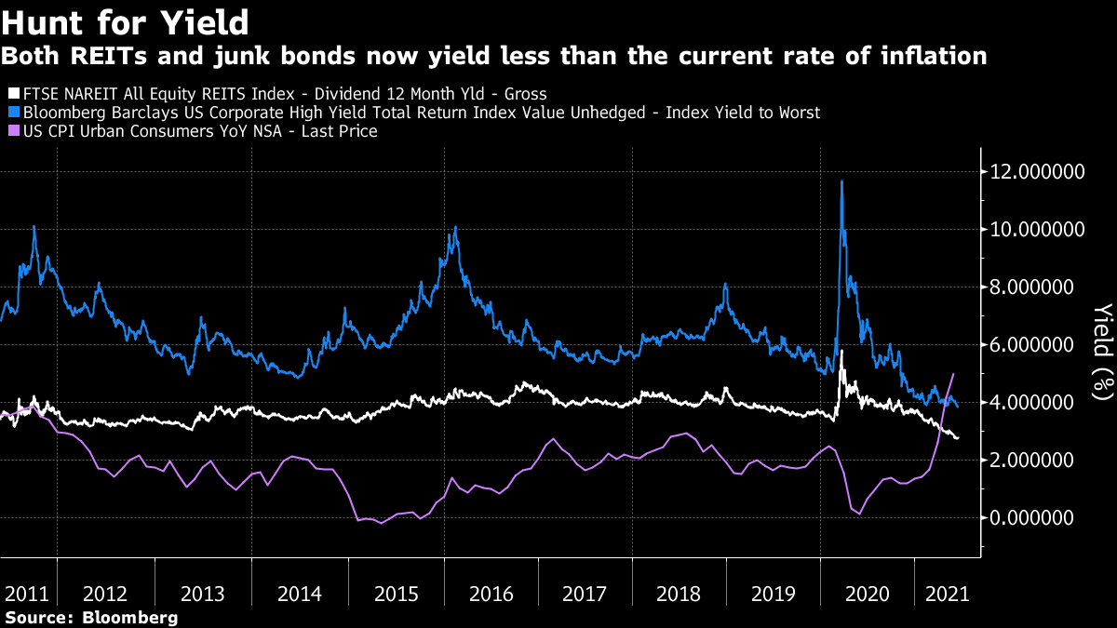

Slide 31
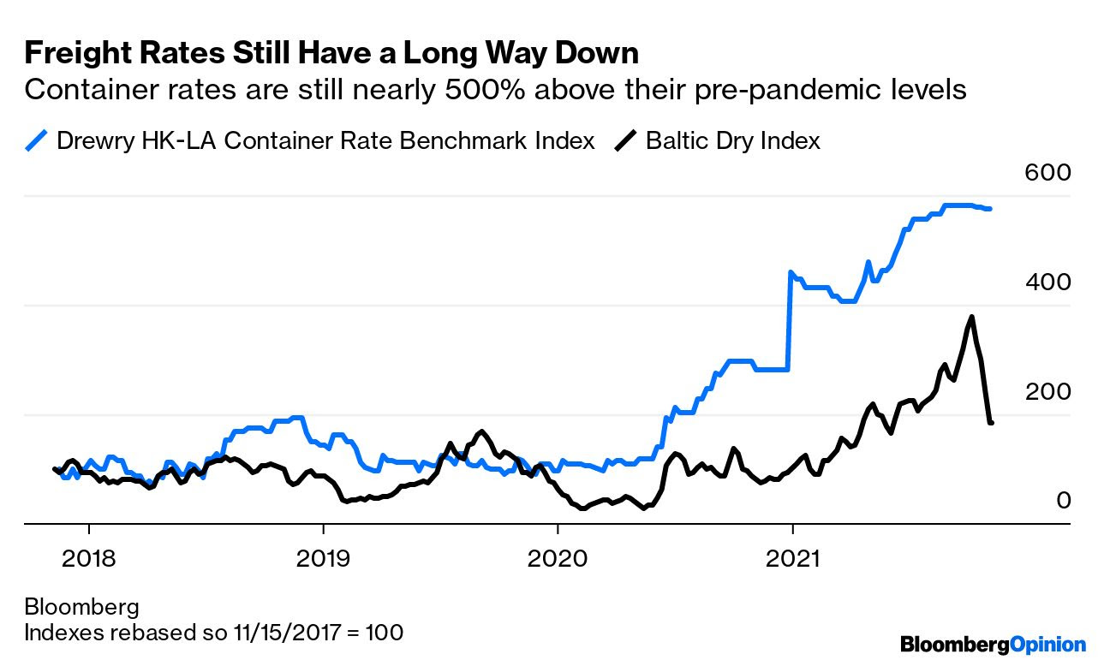

Slide 32
So what?

Slide 33
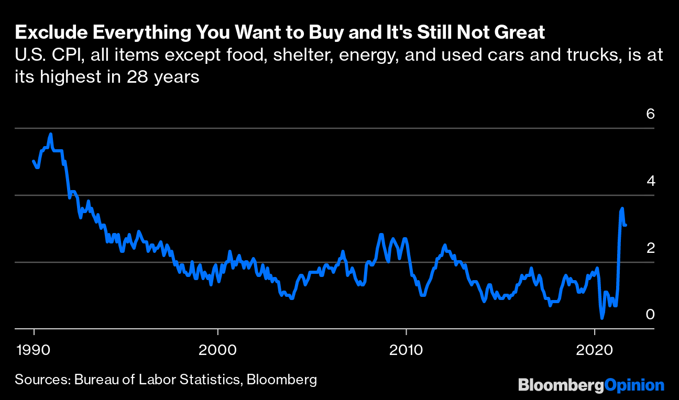

Slide 34
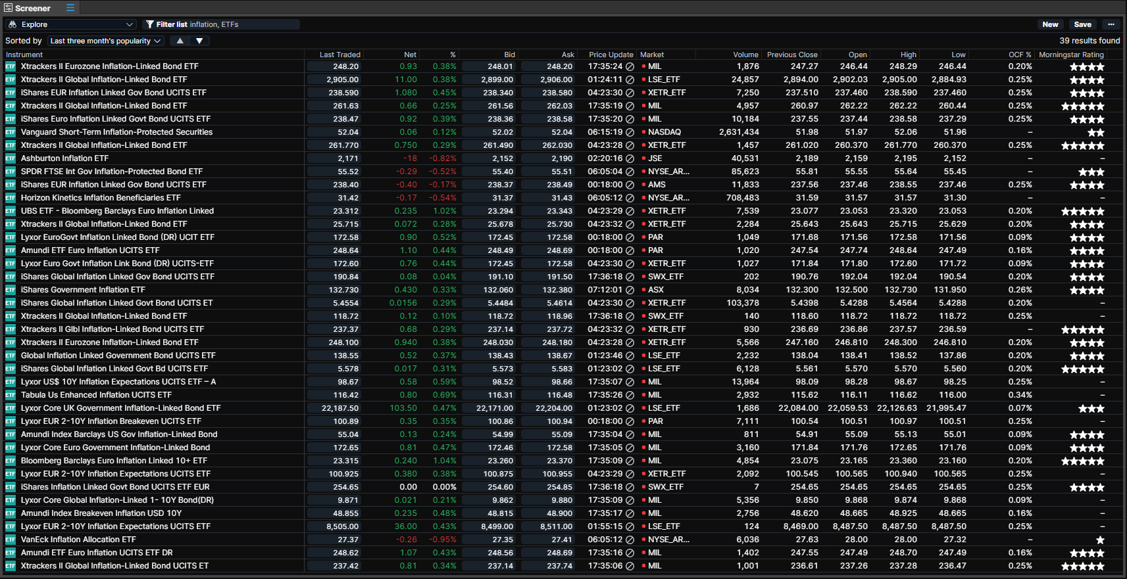
Notes:
Inflation protected products – TIPS mainly, if bonds hard to access, use ETFs tracking them

Slide 35
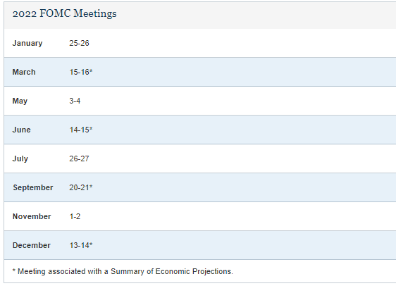

Slide 36
Current state (from a micro-business point of view)

Slide 37
GAS (UK, EU, GER)

Slide 38
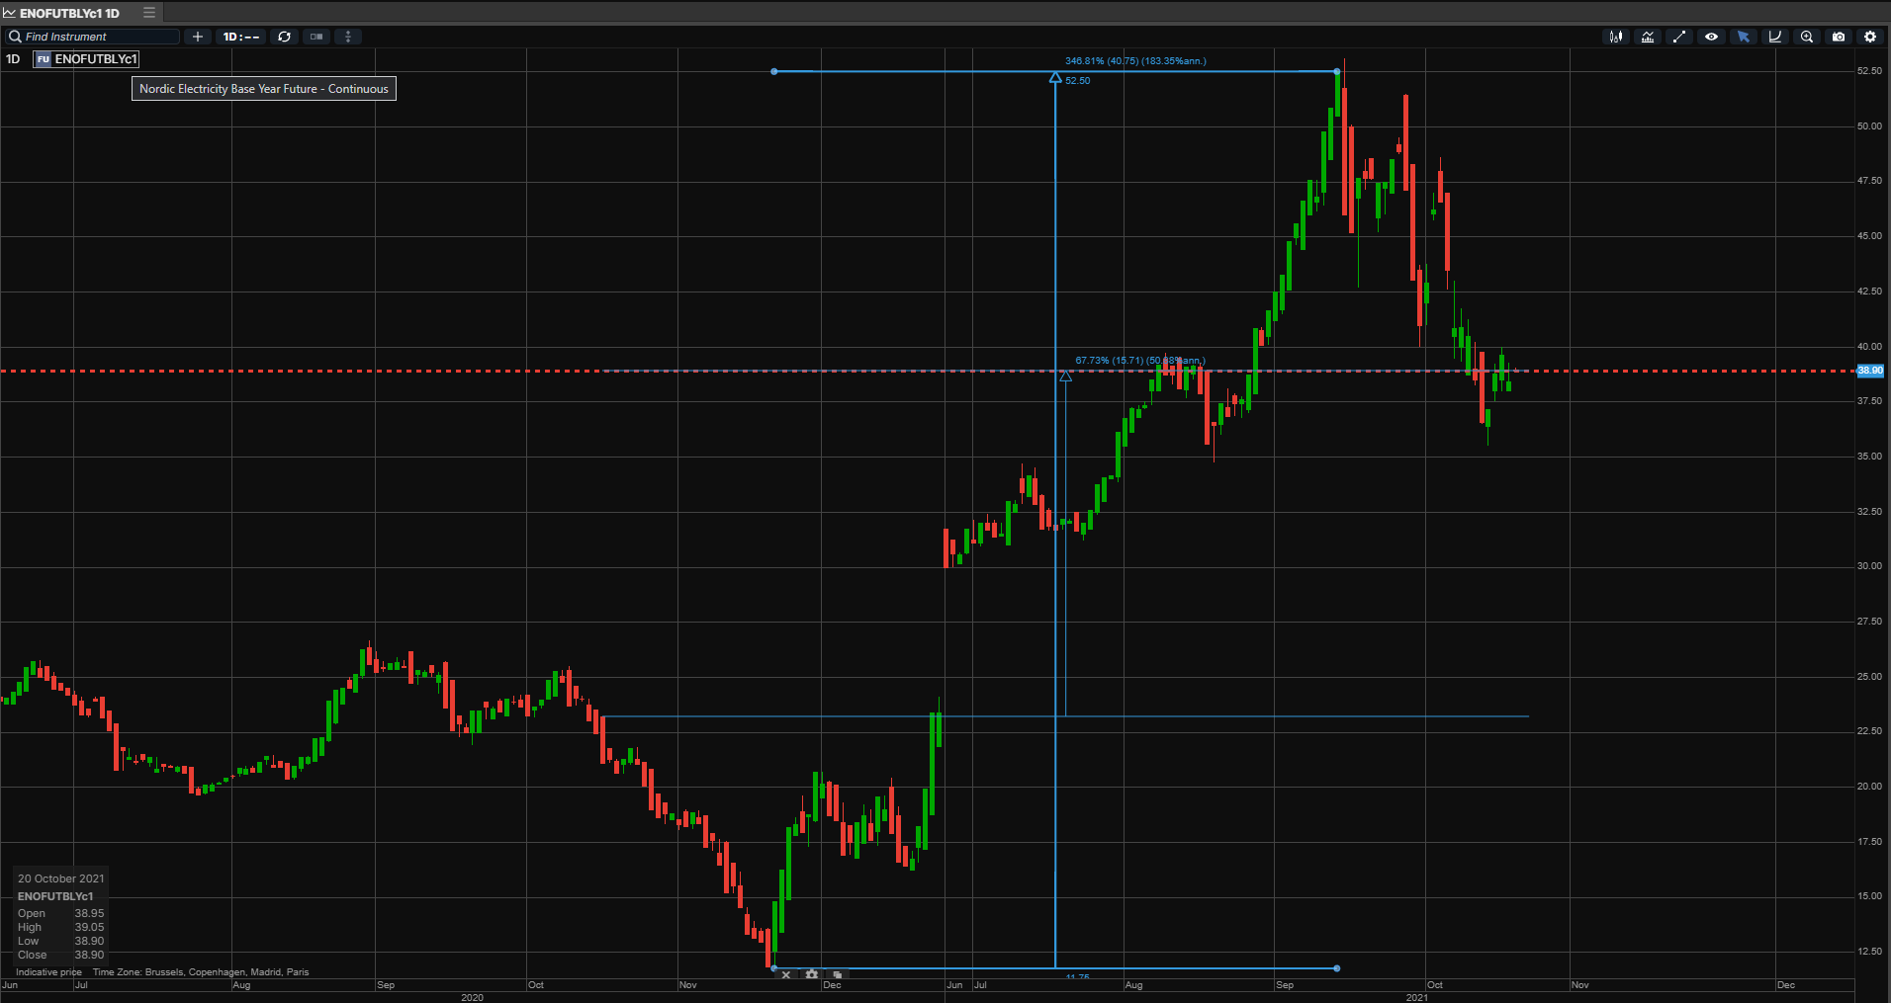
Electricity
Notes:
350 vs 70

Slide 39
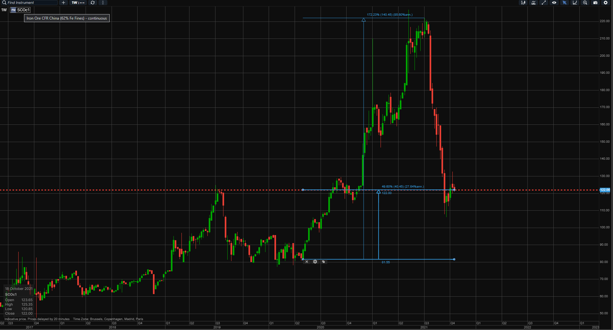
Iron Ore
Notes:
170 vs 50

Slide 40
Oil

Slide 41
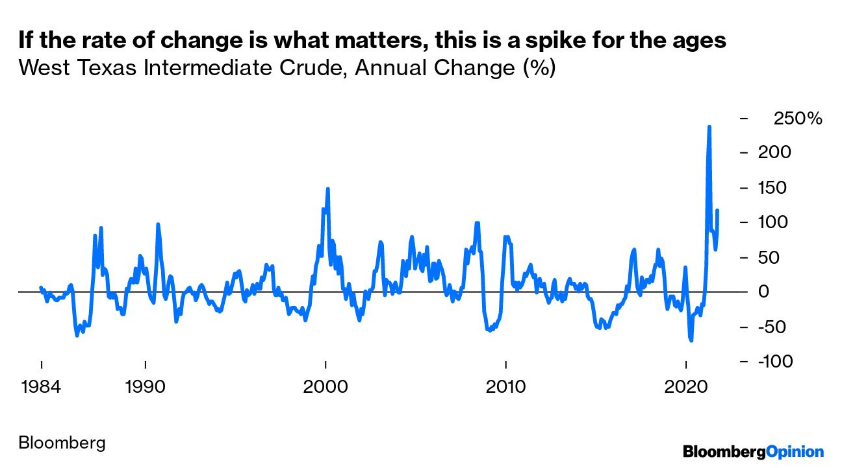
Oil – more complex

Slide 42
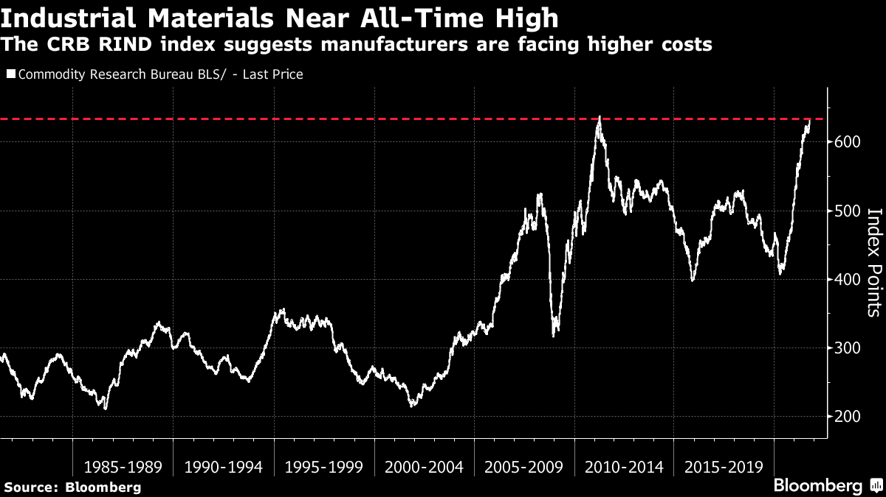

Slide 43
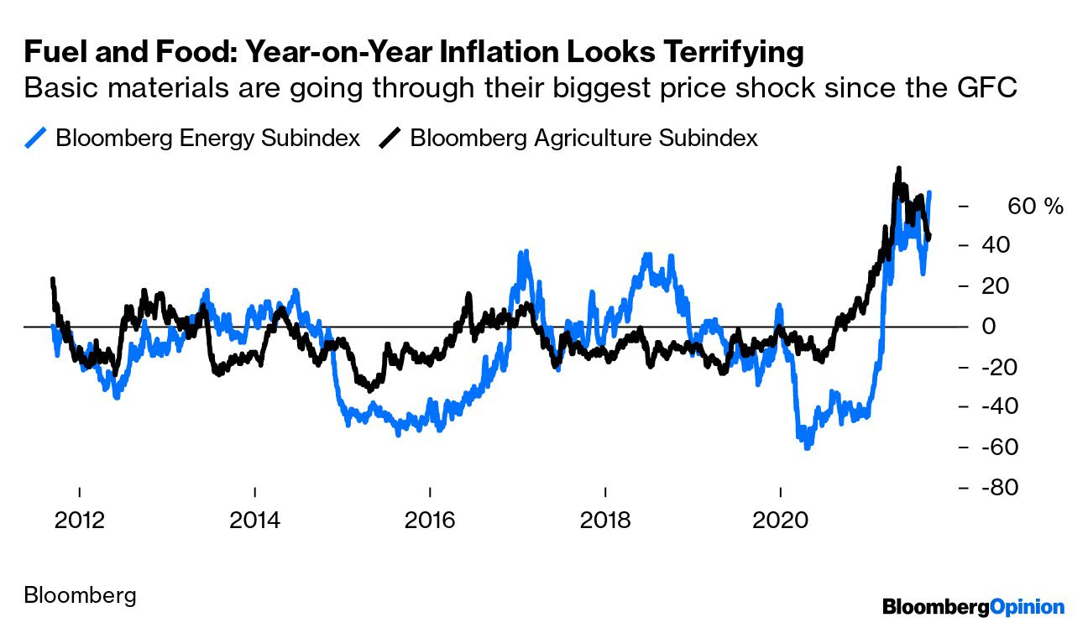
Notes:
CPI reading – 10.12.2021 6.8% - highest since 1984

Slide 44
THANK YOU FOR YOUR ATTENTION!
Any questions?

