Slide 1
Money & Banking
Dr. Jakub Sopko, MSc
TUKE, Košice 2021

Slide 2
Structure
Motivation
Money
FinTech in the present
Interesting facts
Notes:
In the following two teaching units, we would like to take you into the world of finance, money and banking. My topic today is money and banking. (click-next slide)

Slide 3
Motivation
„Money in the bank is like toothpaste in the tube. Easy to take out, hard to put back.“
Earl Wilson
„Money is like an arm or leg – use it or lose it.“
Henry Ford
Notes:
Let's try to start in an unconventional way, with a question ☺ Who among you would like to work in the banking sector? I decided to give you a simple and basic cross-section of this area and maybe we will be able to answer some questions and maybe we will leave some open, which will give you the opportunity to think about them or discuss them in the future. In order to even get ahead of the end of my presentation, I have also prepared for you the so-called additional, enriching material that you can use either individually or, ideally, in a group on similarly focused subjects. There you will find several questions/tasks and open questions. But let's get back to the topic of money and banking. We will imagine their history, position and their forms. Among other things, we will try to point out a kind of premise/bridging between money and banking, while we will also show news in the field of banking, which are mainly related to the development of financial technologies. In the end, several interesting and open questions are prepared for you, which you/we can discuss. (click-next slide)

Slide 4
MONEY AND ITS FORMS

Slide 5
Money and Its Forms (1)
Claims we know well:
  “Money moves the world."
  “The love of money is the source of all evil" (love or lack of it?)
It is important to understand the meaning of money in terms of
  Beliefs
    For example, like the psychology of relationships, desires, expectations
  Personal relationship
    From disdain for money to complete obsession with money
Transition from primitive forms to modern forms of money
Notes:
One of the most famous statements that express the importance of money in our daily lives is the saying that "money makes the world go round". Perhaps more biblical is the warning that "the love of money is the root of all evil." But one might add that lack of money is the cause of all evil. The meaning of these statements is to emphasize the significant personal and moral importance of money for the whole society in a much wider than purely economic sense. Whether we are talking about money in simple terms, sometimes described as primitive, or in much more advanced, complex societies, its definition is often insufficient, especially in terms of defining its meaning. Therefore, even in this case, we can think about how money is understood. Money was and is often associated with faith, which is now interpreted as the psychology of relationships, desires and expectations. Personal attitudes towards money range from disdain for it by one group to total obsession with money on the other. Paradoxically, the first group also includes very rich people. In the case of a rich person, it is because he can entrust his people with the cares of ordinary things, or because the pleasures he can afford far exceed his needs, hence a spontaneous disinterest in money. In the case of a poor person, it is because he is working his way out of dire need, and he is learning to live as best he can with very little money. His expectations must be aligned with reality, which can be considered a form of forced self-denial. The accepted way of life thus limits his demand for money. No individual can possibly afford the pleasure of ignoring money. The interconnectedness of money, consumer discretion, and political freedom can be found in Milton Friedman's "Capitalism and Freedom" or "Freedom of Decision." Mirdala p.9

Slide 6
Money and Its Forms (2)
Money should not only be defined in terms of meaning but also in terms of its functions and purpose
  Means of payment/medium of exchange
  A means of storing value
  Accounting unit
Characteristics of money
  An easily acceptable medium
  Easily divisible media
  They have a known value
  They have a high value-to-weight ratio
  They are hard to fake
Notes:
Of course, we can define a basic view of the functions of money, which I assume many of you have already encountered. Likewise with their defined characteristics. (click - next slide) Mirdala p.9

Slide 7
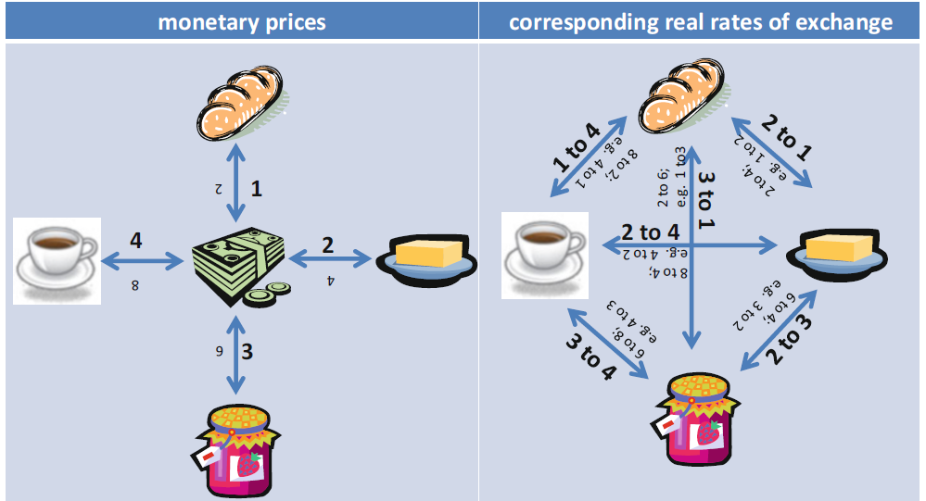
Money and Its Forms (3)
Zdroj: Herger (2019)
Notes:
In addition to functioning as a medium of exchange, money also typically serves as a unit of account or yardstick for measuring the value of economic transactions. In practice, product prices, debts and assets are usually defined in units of the national currency. To this end, we consider the stylized economy shown on the left, which contains only a small number of goods, say bread, butter, jam, and coffee. So on the left we have an expression within the monetary unit, and on the right we can implicitly point to the actual exchange rates between these goods. Exchange rate 2 to 1 between bread and butter, 3 to 1 between bread and jam, 4 to 1 between bread and coffee and so on. The monetary values (shown on the left) are hypothetical because doubling prices does not change actual exchange rates. Money serves as a unit of account even though monetary prices do not in themselves inform about real economic values. So the question is why this is so. The answer is very simple, because the uniform expression of prices in currency units greatly simplifies the comparison of economic value. As the figure on the right shows, without money there are 6 price pairs between 4 goods in a stylized economy. However, when expressed through a common measure, through money, only 4 prices are needed. If we were to look at a larger quantity of goods, this simplification is even greater. For example, there are 499500 price ranges among 1000 goods. If we had a published price for the goods, the number of prices would drop to 999. In particular, although an increase in the general price level does not change the relative exchange rates between goods per se, inflation reduces the value or purchasing power of money. Deflation or a decrease in the average price level causes the opposite effect. Click slide Understanding banks, CFA Program money Bold numbers indicate the value of the product per monetary unit. Bread 1 monetary unit, butter 2 monetary units, etc. Uniform expression of products and their prices in currency units significantly simplifies the system of comparing their economic value. Among the four products without money, there would be 6 common price pairs in the economy. When expressed through money, there are only four (because I express it through money and not between products). With a larger quantity of goods, this comparison is even more striking. There are 499550 price ranges among 1000 goods. However, as soon as you enter a certain currency unit, this number would be at the level of 999.

Slide 8
Money and Its Forms (4)
Barter exchange
  Creating markets
  Gift exchange
Full money
  Commodity money
  Precious metals
  Gold deposit certificates
Incomplete money
  Fiat money
Notes:
In its essence, barter exchange can be described as even older than humanity itself. The direct exchange of services and resources for mutual benefit is inherent in the symbiotic relationship between plants, insects and animals. In practice, barter exchange mainly concerned commodities with the function of a means of exchange. Perhaps the greatest benefit of barter exchange can be seen in the very creation of the first markets in appropriately designated locations. However, with the passage of time and development, money began to fulfill an irreplaceable role. Currently, we can call the money we use fiat money. (money without intrinsic value, not backed by gold/commodities, and mainly by forced circulation that is given by the state). (fiat - from the Latin let it happen - a command that money becomes currency. Barter exchange: Mirdala str. 12-15

Slide 9
Money and Its Forms (5)
Barter Exchange: Disadvantage??
  William Stanley Jevons: Money and the Mechanism of Exchange (1875)
Fun Fact:
Opera singer Mlle Zélie visited the Society Islands (islands in the South Pacific) during her worldwide tour. As a reward for her performance, she received one third of the contributions collected at the entrance fee. So her share represented
  3 pigs,
  23 turkeys,
  44 chickens,
  5000 coconuts
  lots of bananas, lemons and oranges.
She consumed only a negligible amount, and at the same time, before she left, she had to feed the pigs and poultry with fruit. Therefore, a significant part of the contributions went to the outside world.
Notes:
One of the most interesting forms of barter exchange was the mutual exchange of gifts, which within families were perceived more as gifts than the exchange itself. Where, of course, one can look for the connection of money to barter and then explore the advantages and disadvantages associated with it. Several pitfalls of barter exchange and several related examples can be found in the literature. Barter exchange: Mirdala str. 12-15 Jevons, William Stanley, 1875: Money and the Mechanism of Exchange

Slide 10
Money and Its Forms (6)
Yap (Micronesia) - currency Rai (raay)
Notes:
Ray currency in Micronesia, which still works in those ancient tribes. Fair value? About more than 100kg :D but there is definitely a strong intrinsic value and ancient value. https://cs.wikipedia.org/wiki/Rai_(pen%C3%ADze)

Slide 11
Money and Its Forms (7)
Risk: INFLATION
Examples of hyperinflation:
  Russia (1921-1924)
  Germany (1922-1923)
  Hungary (1945-1946)
  Argentina and Brazil (1989-1990)
  Ukraine (1991-1994)
  Zimbabwe (2006-2009)
  Venezuela (2018)
  Cuba (???)
Notes:
The concept of inflation is also closely related to the development and process of money formation. I believe that you can partially imagine something under this term. However, in order not to bother my colleague too much, I'll skip these things for now, anyway, if anyone is interested, you can check it out. Barter exchange: Mirdala str. 12-15 Jevons, William Stanley, 1875: Money and the Mechanism of Exchange

Slide 12
FinTech in the present

Slide 13
FinTech (1)
  Financial technologies use modern technologies to provide financial services. Computers, tablets, and smartphones are gradually replacing humans in customer contact with financial services.
    Online payments
    Electronic wallets
    Mobile payments
    Virtual currencies (cryptocurrencies)
    Investing and saving through applications
Notes:
When it comes to innovation and progress, traditional banks are lagging behind and fintech is advancing. Fintech may have a small share of the world's banking system, but consumers are increasingly choosing to use it as a replacement for banks.

Slide 14
FinTech (2)
  Hotovostné a bezhotovostné platby
    Predpokladom ich uskutočnenia je vlastniť určitý typ účtu
    Vklad/výber hotovosti
    Prevodný príkaz
    Inkaso
    SIPO
    Platba debetnými a kreditnými kartami
    Bezkontaktné platby
  Fun Fact:
  Priateľský bol ku svojim klientom bankomat poľskej banky PKO v Toruni, ktorý klientom počas noci vyplácal 2x viac peňazí, ako žiadali a ako im bolo odpočítané z účtu. Kamerový systém odhalil, že niektorí zákazníci sa k štedrému bankomatu vrátili behom tejto „poruchy“ hneď niekoľkokrát. Najaktívnejší boli dvaja policajti v uniforme, ktorí výber peňazí opakovali 33x ☺
  Zdroj: PKO

Slide 15
FinTech (2)
  Cash and non-cash payments
    The prerequisite for their implementation is to have a certain type of account
    Cash deposit/withdrawal
    Transfer order
    Direct debit
    SIPO
    Payment by debit and credit cards
    Contactless payments
  Fun Fact:
  The ATM of the Polish bank PKO in Toruń was friendly to its clients, and during the night it paid clients twice as much money as they requested and as was deducted from their account. The camera system revealed that some customers returned to the generous ATM several times during this "outage". The most active were two policemen in uniform, who repeated the withdrawal of money 33 times ☺
  Source: PKO

Slide 16
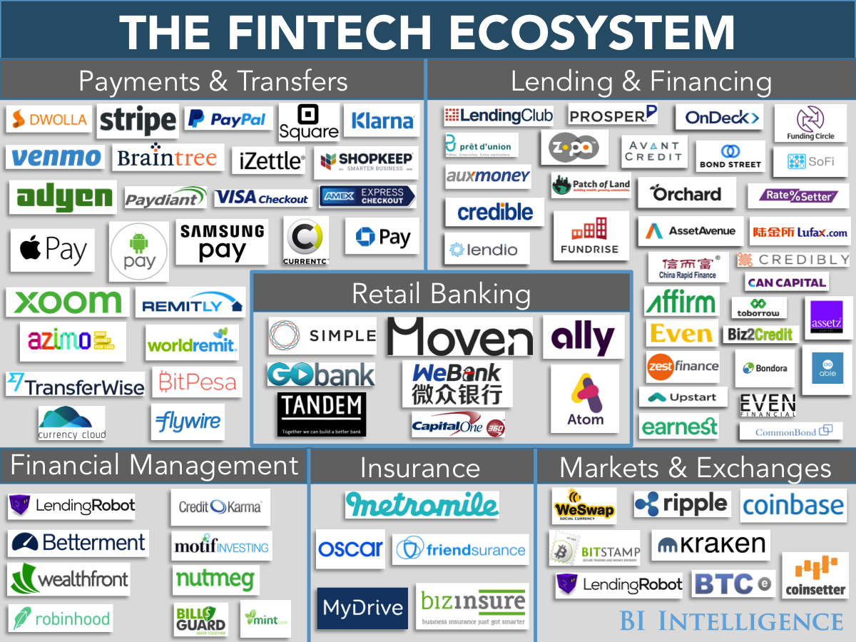
FinTech (3)
Zdroj:
Sanjiv R. Das (2019)
+
Map of advisors
Notes:
Would you be able to determine what the individual applications/logos represent??

Slide 17
FinTech (4)
Source:
Sanjiv R. Das (2019)
+
Map of advisors
Notes:
Would you be able to determine what the individual applications/logos represent??

Slide 18
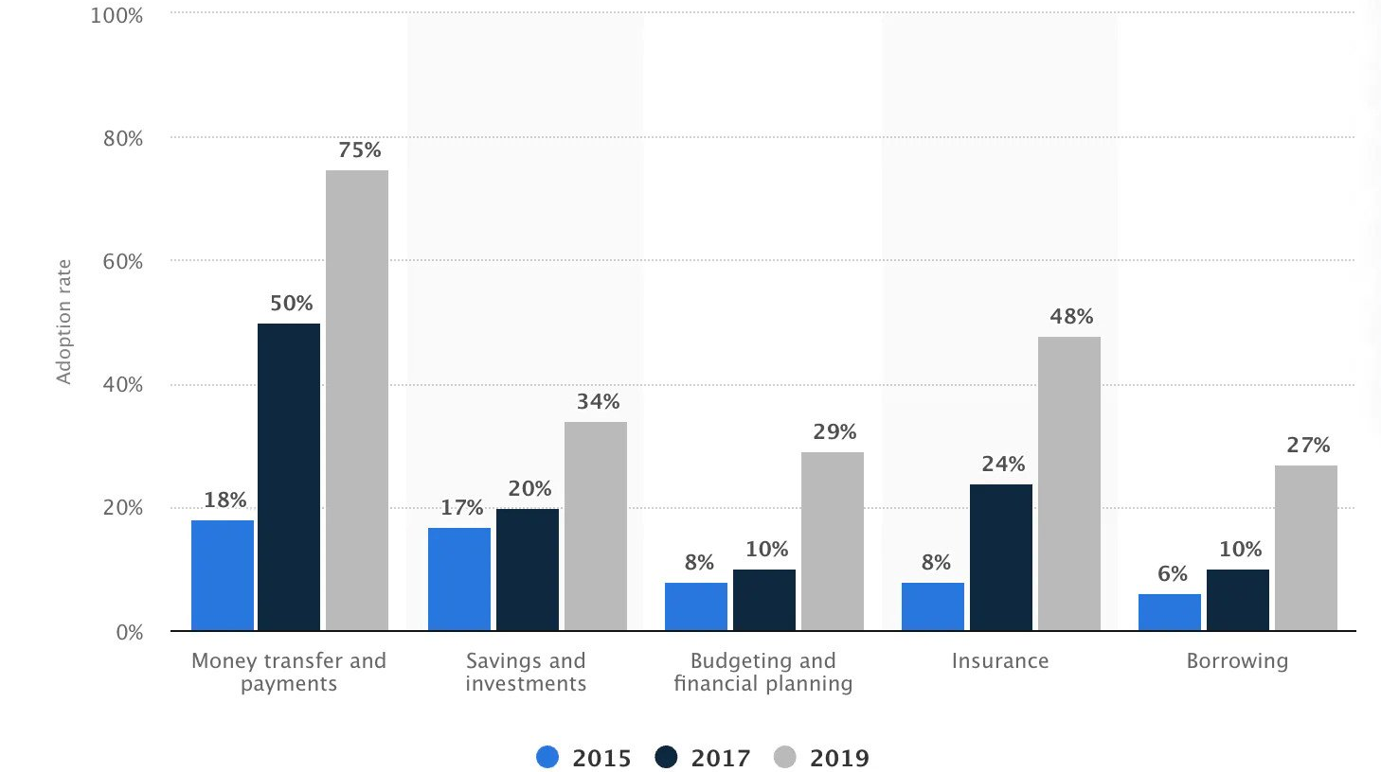
FinTech (5)
  Source: Monei.com
Notes:
According to Statista, between 2015 and 2019, consumer adoption of fintech companies and products grew rapidly worldwide. By 2019, 75% of consumers worldwide have started using some form of money transfer and/or payment service. https://monei.com/blog/fintech-vs-traditional-banks/

Slide 19
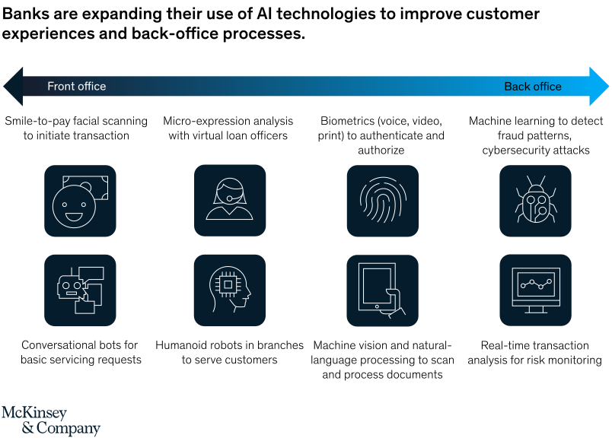
FinTech (6)
  Source: McKinsey
Notes:
Artificial intelligence technologies are becoming increasingly important in the environment we live in, and banks need to deploy these technologies on a large scale to remain competitive. Success requires transformation involving multiple layers of organizational change. Mckinsey & company is an American consulting firm with worldwide operations, and it is one of the most prestigious consulting companies in the world, with more than 80% of the world's largest companies as its customers. For global banking, McKinsey estimates that AI technologies could potentially add up to $1 trillion in added value each year. Let's look at some of the results of a survey conducted by this company across leading financial institutions. He can confirm that the use of advanced artificial intelligence technologies by leading financial institutions is constantly increasing. Nearly 60 percent of financial services respondents to McKinsey's Global AI Survey report that their companies have at least one AI capability built into them. The most frequently used AI technologies are: robotic process automation (36 percent) for structured operational tasks; virtual assistants or conversational interfaces (32 percent) for customer service divisions; and machine learning techniques (25 percent) to detect fraud and support underwriting and risk management. While the use of AI in many financial services firms is episodic and focused on specific use cases, a growing number of leading banking companies are taking a comprehensive approach to deploying advanced AI, integrating it throughout the lifecycle, from the front end to the back-office. https://www.mckinsey.com/industries/financial-services/our-insights/ai-bank-of-the-future-can-banks-meet-the-ai-challenge

Slide 20
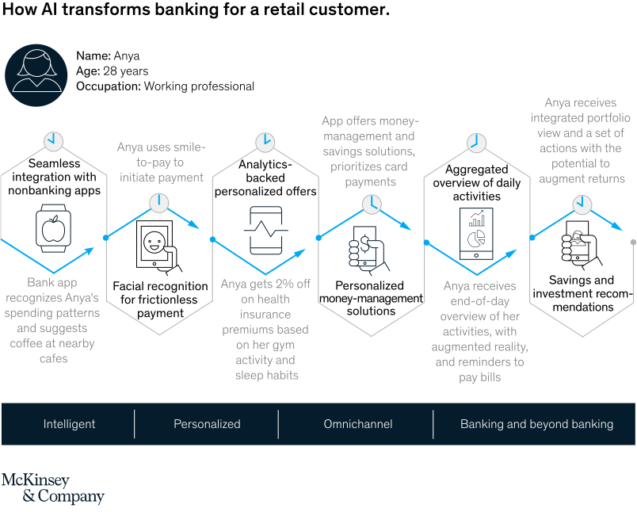
FinTech (7)
  Zdroj: McKinsey
Notes:
To meet rising customer expectations and defeat competitive threats in the AI-driven digital era, the AI-first bank will offer propositions and experiences that are intelligent (i.e. recommending steps by step, predicting and automating key decisions or tasks), personalized (i.e. relevant and up-to-date and is based on a detailed understanding of past customer behavior and context and is truly omni-channel (seamlessly spanning physical and online contexts across multiple devices and delivering a consistent experience) and connects banking functions with relevant products and services beyond banking.The figure illustrates how it would such a bank could engage a retail customer during the day. https://www.mckinsey.com/industries/financial-services/our-insights/ai-bank-of-the-future-can-banks-meet-the-ai-challenge

Slide 21
Summary
  "Money moves the world."
  The history of money and banking teaches us to prepare for new challenges
  Financial technologies and AI - the future in banking as well
  Risk - Inflation
  „...Within our mandate, the ECB is ready to do whatever it takes to preserve the euro. And believe me, it will be enough.“
  Mario Draghi (2012)
Notes:
But there is another message I want to tell you.
Within our mandate, the ECB is ready to do whatever it takes to preserve the euro. And believe me, it will be enough.
https://www.ecb.europa.eu/press/key/date/2012/html/sp120726.en.html
Christine Lagarde-new ECB president

Slide 22
Interesting Facts

Slide 23
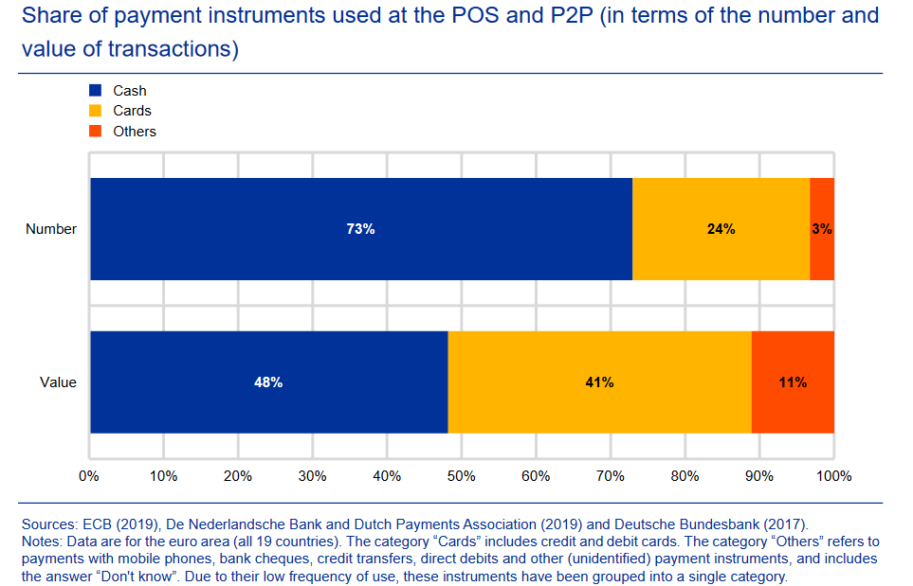

Slide 24
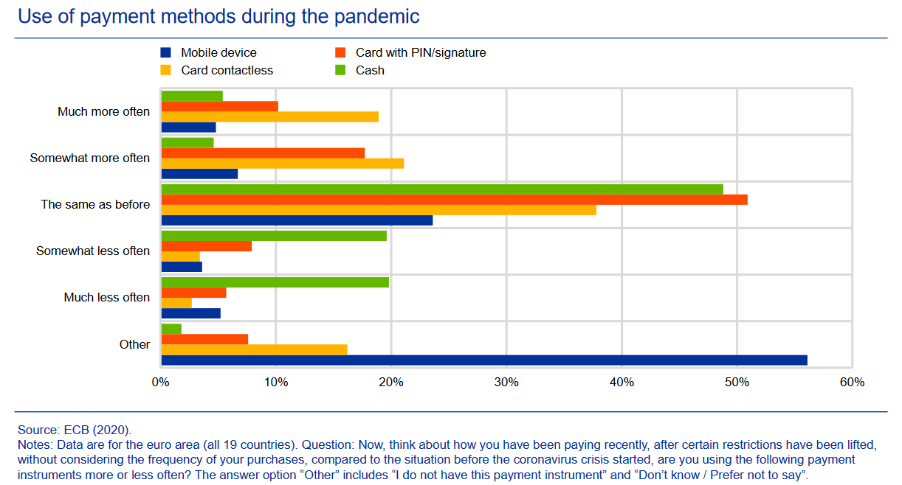
Notes:
IMPACT survey: the impact of the pandemic on cash trends (2020) It can be observed that the share of cash use among residents during the pandemic did not change rapidly, which we can see with the option (same as before), but there is an indication that people used card payments more often due to the pandemic. (much more often, somewhat often)

Slide 25
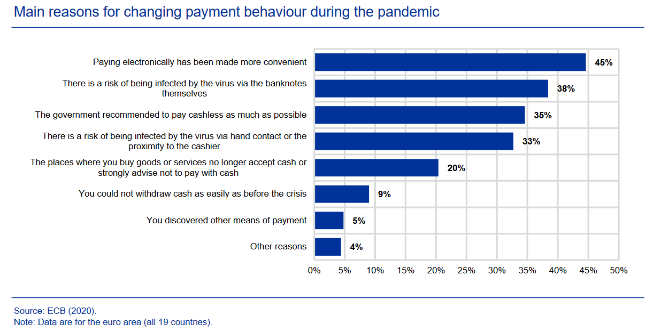
Notes:
IMPACT survey: the impact of the pandemic on cash trends (2020)

Slide 26
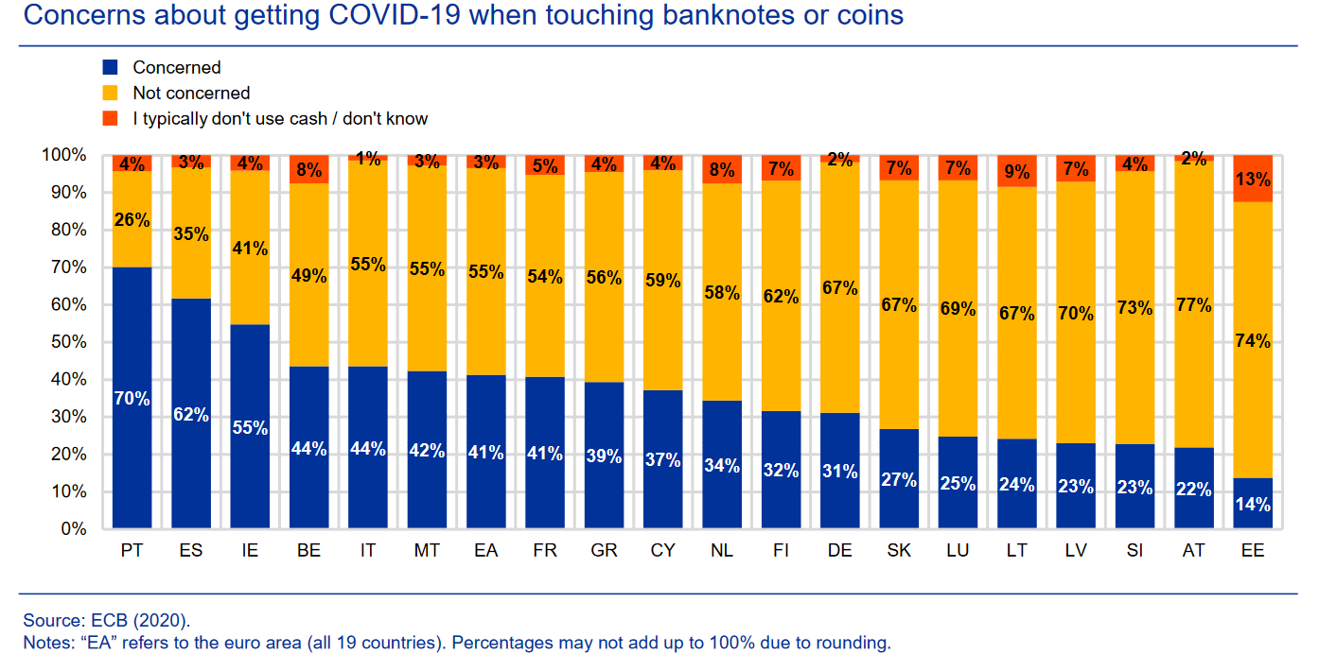
Notes:
IMPACT survey: the impact of the pandemic on cash trends (2020)

Slide 27
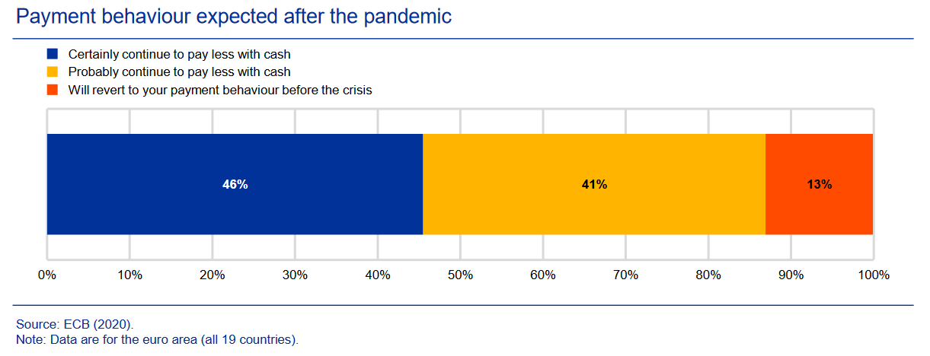
Notes:
IMPACT survey: the impact of the pandemic on cash trends (2020)
87% of the respondents who stated that they had paid less in cash (i.e. 40%; see Chart A) said that they would continue to do so when the coronavirus crisis is over, of which 46% said that they were certain that they would continue to do so (see Chart D).

Slide 28
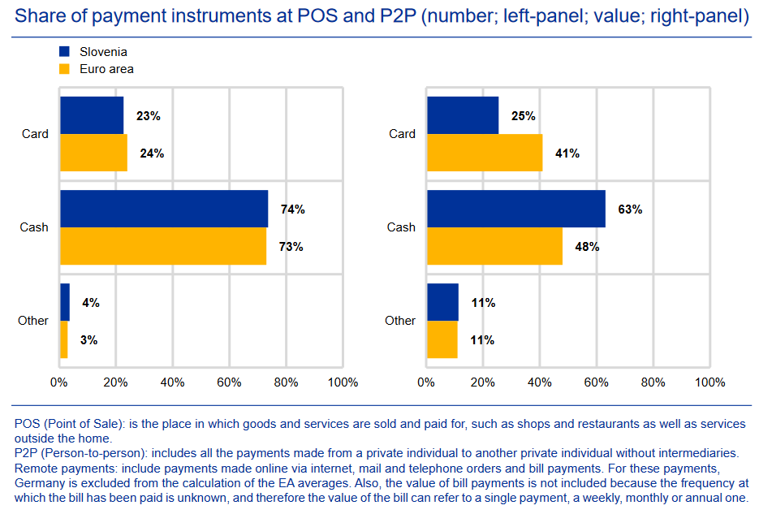
Slovakia
Notes:
IMPACT survey: the impact of the pandemic on cash trends (2020)
87% of the respondents who stated that they had paid less in cash (i.e. 40%; see Chart A) said that they would continue to do so when the coronavirus crisis is over, of which 46% said that they were certain that they would continue to do so (see Chart D).

Slide 29
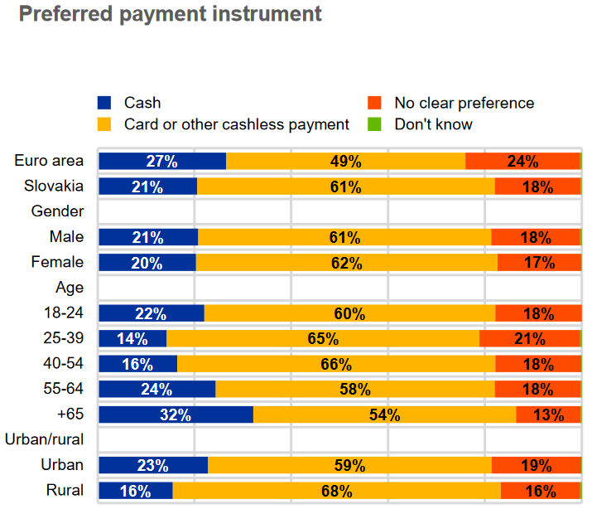
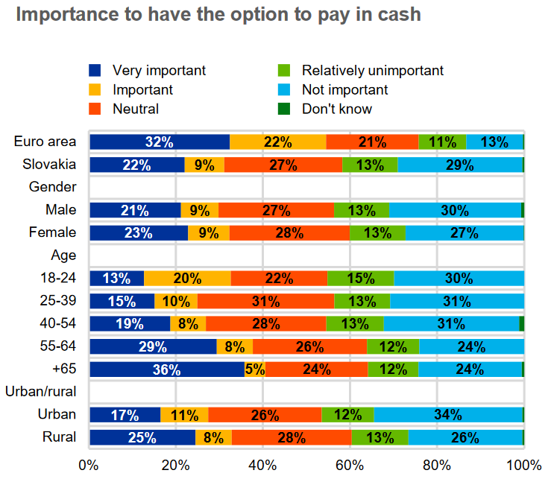
Notes:
IMPACT survey: the impact of the pandemic on cash trends (2020)
87% of the respondents who stated that they had paid less in cash (i.e. 40%; see Chart A) said that they would continue to do so when the coronavirus crisis is over, of which 46% said that they were certain that they would continue to do so (see Chart D).

Slide 30
Resources
Bilan, A., Degryse, H., O’Flynn, K., & Ongena, S. (2019). Banking and Financial Markets: How Banks and Financial Technology Are Reshaping Financial Markets. Springer Nature.
de Beaufort Wijnholds, O. (2020). The Money Masters. Springer International Publishing.
Gortsos, C. V. (2020). European Central Banking Law: The Role of the European Central Bank and National Central Banks under European Law. Palgrave Macmillan Studies in Banking and Financial Institutions.
Herger, N. (2019). Understanding central banks. Springer.
Tanda, A., & Schena, C. M. (2019). FinTech, BigTech and Banks: Digitalisation and Its Impact on Banking Business Models. Springer.

Slide 31
THANK YOU FOR YOUR ATTENTION!
Any questions?

