Slide 1
INTEREST AND DEBT
Ing. Darya Dancaková, PhD.
Department of Banking and Investment

Slide 2
Debt definition. Public and private debt.
Debt = is a subset of liabilities or financial obligations that a party must make. Debt can involve real property, money, services, or other consideration.
Debt
Public (government)
Private (households, companies)

Slide 3
Why do people borrow money?
To get quick access to finance for covering short- and long-term needs;
To buy expensive goods;
To solve short-term financial problems;

Slide 4
Who borrows most?
Average debt per person in Slovakia: €7,990 (Source: Trend.sk, 2020)
Average debt per person in Great Britain: £9,246 (Source: Money.co.uk, 2021)
Average debt per person in USA: $ 90,460 (Source: CNBC report, 2021)

Slide 5
How much do personal loans cost?
Do not compare advertised interest rates, but always look at the APRC!
INTEREST |  | INTEREST RATE |  | APR
Notes:
Interest is the amount of money you pay for your borrowings or the amount of money you earn from your savings
Interest rate is the cost of borrowing the principal, expressed as percentage of loan (for instance 6% p.a.)
sumy (napr. 4,5% p.a.)
APR is the total cost of your loan or mortgage including interest rate and other additional fees

Slide 6
The time value of money
The value of money changes over time… „a dollar today is worth more than a dollar tomorrow “
Present value | Future value
$$PV= \frac{1}{{(1+i)}^{n}}$$ | $$FV={(1+i)}^{n}$$
Notes:
The time value of money is a concept that states a dollar today is always worth more than a dollar tomorrow (or a year from now). One reason for this is the opportunity costs of holding cash instead of investing in higher-return projects. It also arises due to inflation.

Slide 7
How does it work?
Suppose you borrow €25,000 for 8 years at interest rate of 3.5% p.a.
What is the value of the debt at the end of the 8th year?
Future value | Present value
$$FV={25 000∗(1+0,035)}^{8}=32 920,23 €$$ | $$PV= \frac{32 920,23}{{(1+0,035)}^{8}}=25 000 €$$

Slide 8
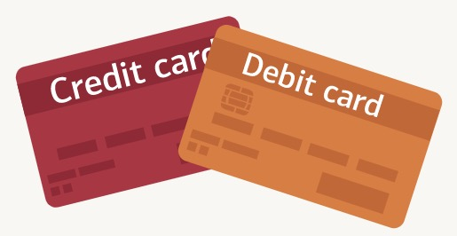
Types of loans and credit
Credit card/authorized bank account overdraft;
Consumer credit;
Mortgage (buying a house, reconstruction);
Credit from non-bank lenders.
Do you know the difference between a debit and a credit card?
Notes:
Debit cards are linked to your bank account, so every time you make a purchase, the amount is automatically deducted from your account. A credit card offers a line of credit that lets you borrow money to make purchases.

Slide 9
Credit card
A credit card is a type of payment card which offers a line of credit that lets you borrow money to make purchases.
Every new payment = new borrowing (new credit)
Grace period when the interest is put on hold from 30 to 55 days (depending on your bank)
Pros: you can pay for emergencies, even if you don’t have the cash on hand; 0% interest period;
Cons: over-limit fees, penalties, charges, high interest, etc.
What are the benefits of a credit card?
Notes:
There are many advantages to using a credit card. Some of the benefits include:
Convenience. Using a credit card lets you buy something today but put off the real cost until payday rolls around – so you don’t have to wait
Cashback and rewards. Many credit card providers offer a range of rewards to customers. You could be getting air miles or similar shopper loyalty points each time you use your card, or even cashback on purchases

Slide 10
Credit card – case study
John took a consumer loan and was proposed to use a credit card issued by his bank. The billing date of a credit card is 3rd of every month, and the payment due date is 15th of the same month. The minimum amount due is 5% of the total outstanding on the credit card. It represents the least sum of money that John must pay every month towards his outstanding bill on the credit card.
Credit card monthly limit is EUR 6,500 (the maximum amount you can borrow)
Interest rate 19.5% p.a.
Penalty interest rate 5% p.a.
John can spend or withdraw up to 6,500 euros every month. He has already spent 500 euros in April. If he returns this amount by the 15th of the next month, no interest will be charged. However, if he does not pay his balance in full by the due date, he will have to pay interest at the rate of 19.5% for the entire amount that he spent in the previous month, i.e. the previous billing period. This means that the interest is EUR 97.5. In addition, John must keep in mind the minimum amount due of 5%, he is required to pay every month. In this case, it is EUR 25. If he make late payments, he will be charged with a penalty interest of 5%.

Slide 11
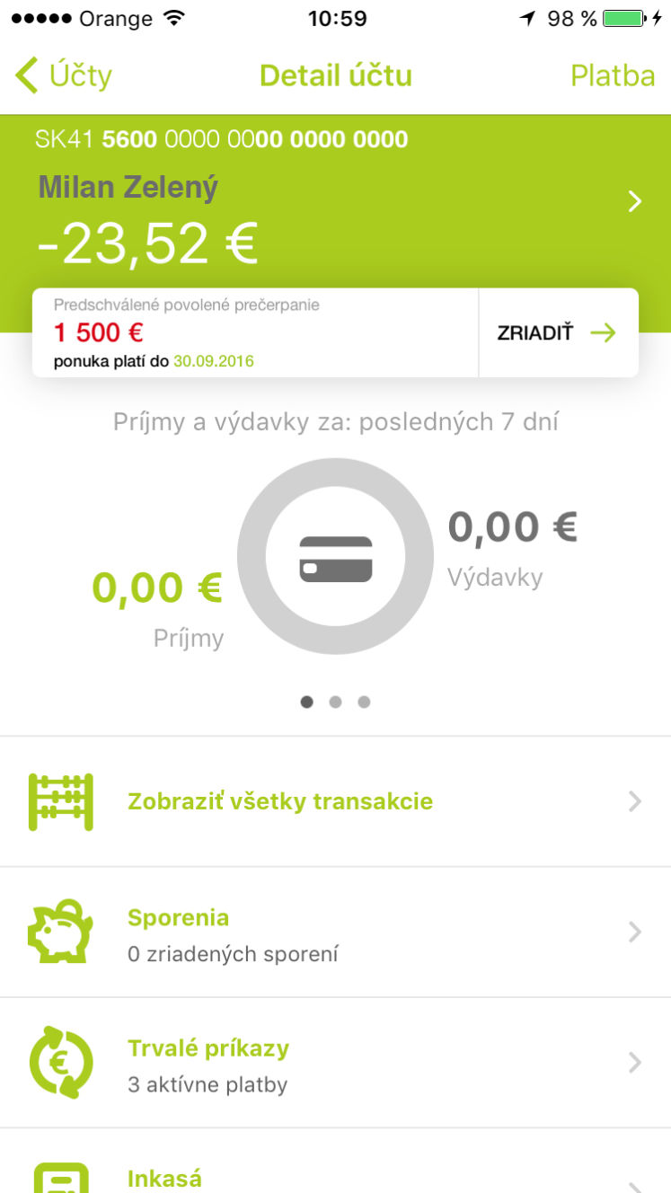
Authorized overdraft
This is an authorized overdraft of funds on your bank account;
An overdraft is like any other loan: the account holder pays interest on it and will typically be charged a one-time insufficient funds fee;
An approved credit limit up to EUR 5000;
The amount due does not have to be paid at the end of the month;
Any amount that comes to your account automatically reduces the sum of your borrowed amount;
Pros: you can easily withdraw money, pay with a card even if there are no funds on your account
Cons: higher interest rates about 19% p.a.
What is the difference between authorized and unauthorized overdraft?
Notes:
Unauthorised overdrafts: these are also known as 'unplanned' or 'unarranged' overdrafts and happen when you spend more than you have in your bank account without agreeing it in advance. This includes going over the limit of an authorised overdraft.

Slide 12
Authorized overdraft – case study
John has an authorized overdraft linked to his bank account. He wants to buy new smartphone for € 600, however his checking account balance is only €100. Since John still lives with parents and doesn’t pay them any rent, he decided to buy the phone immediately. After completing his order in the e-shop, he paid online with his card and overdraft his bank account by € 500. John plans to pay back his overdrawn account as soon as he has enough money, however his monthly salary comes only next month, so he will be charged an overdraft fee.
Interest rate19.0% p.a.
Monthly interest payable: €8.57
Was it a reasonable purchase?

Slide 13
Consumer credit or loan
Is a short-term loan used to finance the purchase of goods or services;
Repayment period from 1 to 8 years.
Pros: without providing a security to the bank, cheaper than credit card (lower interest rates and fees);
Cons: higher total costs with longer repayment periods.

Slide 14
Consumer credit – case study
John wants to buy a new car, so he applied for a consumer credit in the amount of € 20,000. He asked two banks to prepare an offer. Which one should he accept?
Will be the purchased item useful even at the time of the last installment (after 8 years)?
Bank | SLSP | TB
Interest rate | 5,99 % | 5,99 %
APR | 7,99 % | 6,68 %
Monthly payment | €279.81 | €236.54
Total amount paid | €26,861.76 | €25,599.84

Slide 15
Mortgage
Is a long-term loan for housing (buying family house, apartment of building land);
Repayment period up to 30 years;
Pros: low interest rates, longer repayment period;
Cons: security against property needed, mortgage amount only up to 70 %, 80 %, 90% LTV (loan to value)

Slide 16
Budget rule 10:20:30:40
10 = Financial reserve
20 = Long-term assets
30 = Loan installments
40 = Consumption
John earns € 1,000. He is single, without children and lives with parents without paying them a rent. Until now, he was spending all his money on entertainment, but now he wants to buy his own apartment. How should he plan his monthly budget to manage his money wisely?
Financial reserve | €100
Retirement savings, life insurance | €200
Maximum loan installment | €300
Consumption:household,traveling, hobby and free time | €400

Slide 17
If I can not repay my loan…
Late payments
Skip payments for several months
Personal bankruptcy
Distrait of debtor

Slide 18
Number facts to think about…
More than 1.38 mil. of active distractions of the debtors asstes in Slovakia (December 2020)
More than 162,000 submitted requests for skipping payments in Slovakia (June 2020)
3,636 personal bankruptcies (March 2020) and 1,250 (March 2021)

Slide 19
Thank you for your attention

