Slide 1
COMMUNICATION & ACTIVE LISTENING
Ing. Kateřina Kashi, Ph.D.

Slide 2
Content
Communication
Active listening
Feedback

Slide 3
Communication
Communication belongs among the most important tools of human communication, information exchange etc. It also influences and forms interpersonal relationships.
Is the purposeful activity of information exchange between two or more participants in order to convey or receive the intended meanings through a shared system of signs and rules.

Slide 4
Basic functions of speech
Sharing information
Attitude,
Influencing
Interaction

Slide 5
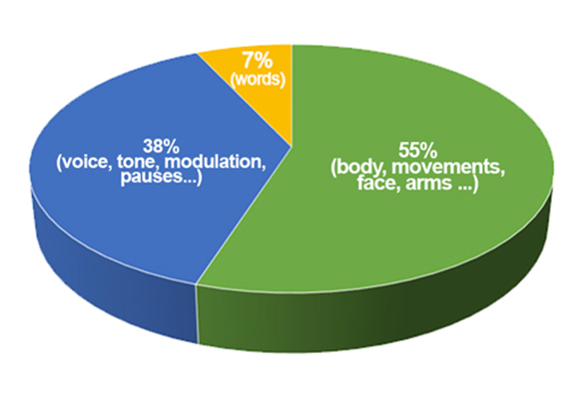
Ways of communication
Verbal – written, spoken, read words
Nonverbal– facial expressions, gestures, proxemics, haptics, paralanguage
Conative – what do we do, how do we behave
Interpersonal Communication – the ability to „move“ clear and exact information among individuals with the aim to influence their actions, behavior and perception.

Slide 6
Proxemics
proxemics - distance between communicators
4 basic zones:
intimate zone - distance of communicators up to 45-60 cm, e.g. partners
personal zone - distance approx. 45 (60) cm - 120 cm, e.g. family
social zone - distance about 120 cm - 3m, e.g. working environment
public zone - distance from about 3 m, e.g. lecture, theater performance distance for each individual, varies according to temperament, nationality, etc.
proxemic dance

Slide 7
Active listening
Listening is an intellectual and emotional process in which a receiver processes physical, emotional, and intellectual messages from a sender in search of meaning.
Active listening means refraining from evaluating other people’s words, trying to see things from their point of view, and demonstrating that you are trying to truly understand.

Slide 8
Principles of Active Listening
L – look interested
I – inquire with questions
S – stay on target
T – test of understanding
E – Evaluate the message
N – neutralise your feelings

Slide 9
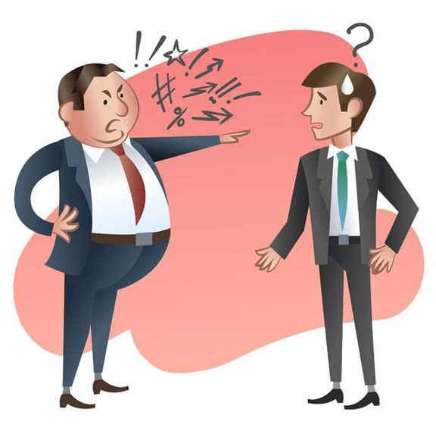
Rules for Giving Feedback
1. Make sure your comments are intended to help the recipient.
2. Speak directly and with feeling
3. Describe what the person is doing and the effect the person is having.
4. Don´t be threatening or judgmental.
5. Be specific, not general (use clear and recent examples).
6. Give feedback when the recipient is open to accepting it.
7. Check to ensure the validity of your statements.
8. Include only things the receiver can do something about.
9. Don´t overwhelm the person with more than can be handled.

Slide 10
Rules for Receiving Feedback
1. Don´t be defensive.
2. Seek specific examples.
3. Be sure you understand (summarize).
4. Share your feelings about the comments.
5. Ask for definitions.
6. Check out underlying assumptions.
7. Be sensitive to the sender’s nonverbal messages.
8. Ask questions to clarify.

Slide 11
Thank you for your attention!
Questions?

