Slide 1
Studying in Huddersfield 2019/20

Slide 2
Huddersfield
University of Huddersfield
Huddersfield Business School
Arriving and Living in Huddersfield

Slide 3
Huddersfield

Slide 4
Location
Edinburgh
Newcastle
Huddersfield
Leeds
Huddersfield
London
Manchester

Slide 5
Surroundings

Slide 6
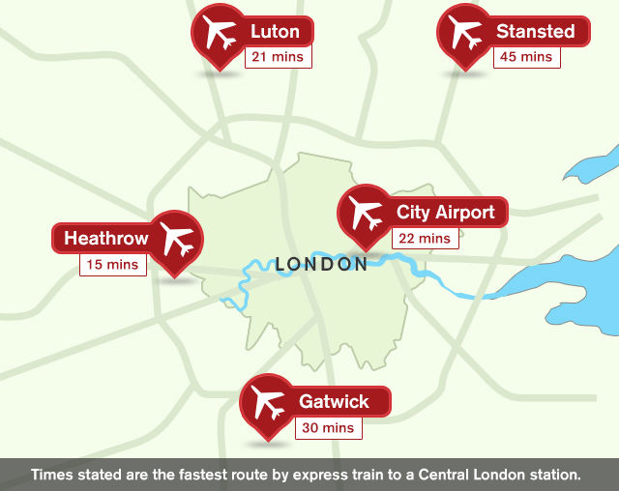
Getting IN …

Slide 7
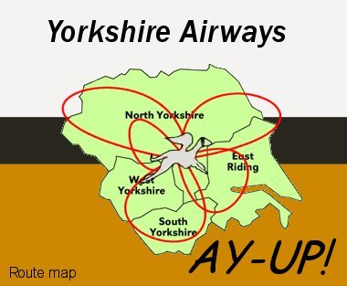
… OUT …
… once you’re in, you’re in because … if it’s outside of Yorkshire, it’s not worth visiting …

Slide 8
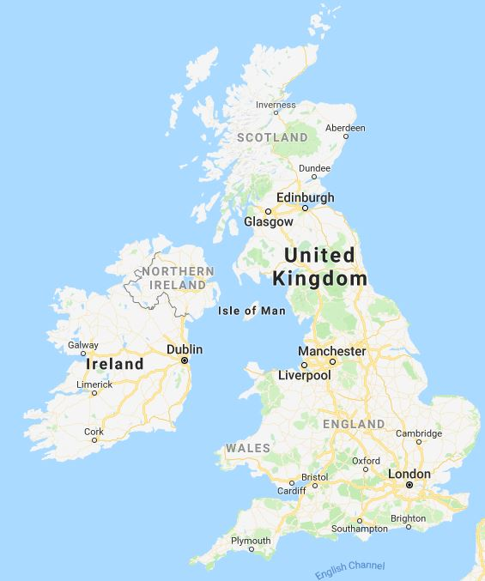
… and ABOUT by train …

Slide 9
… or by bus
Locally
Local buses run regularly and connect all areas of Huddersfield very well
Bus prices are slightly higher than in other countries
You can plan your travels around Yorkshire on the following website: www.wymetro.com
Nationwide
Coach prices are very cheap compared to trains for long distance travels
You can travel with megabus or National Express

Slide 10
University of Huddersfield

Slide 11
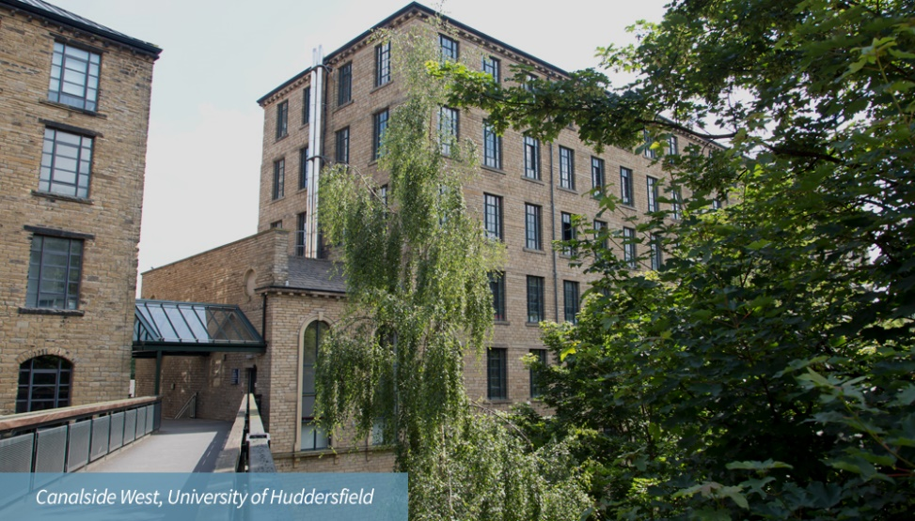
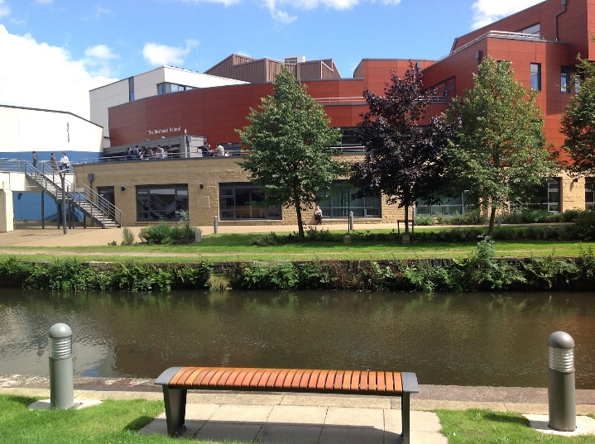
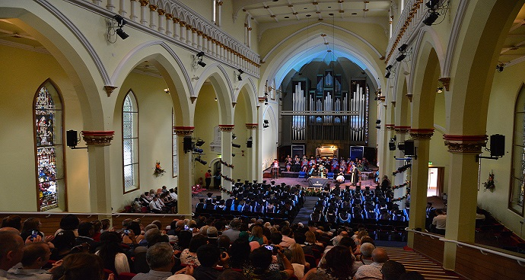
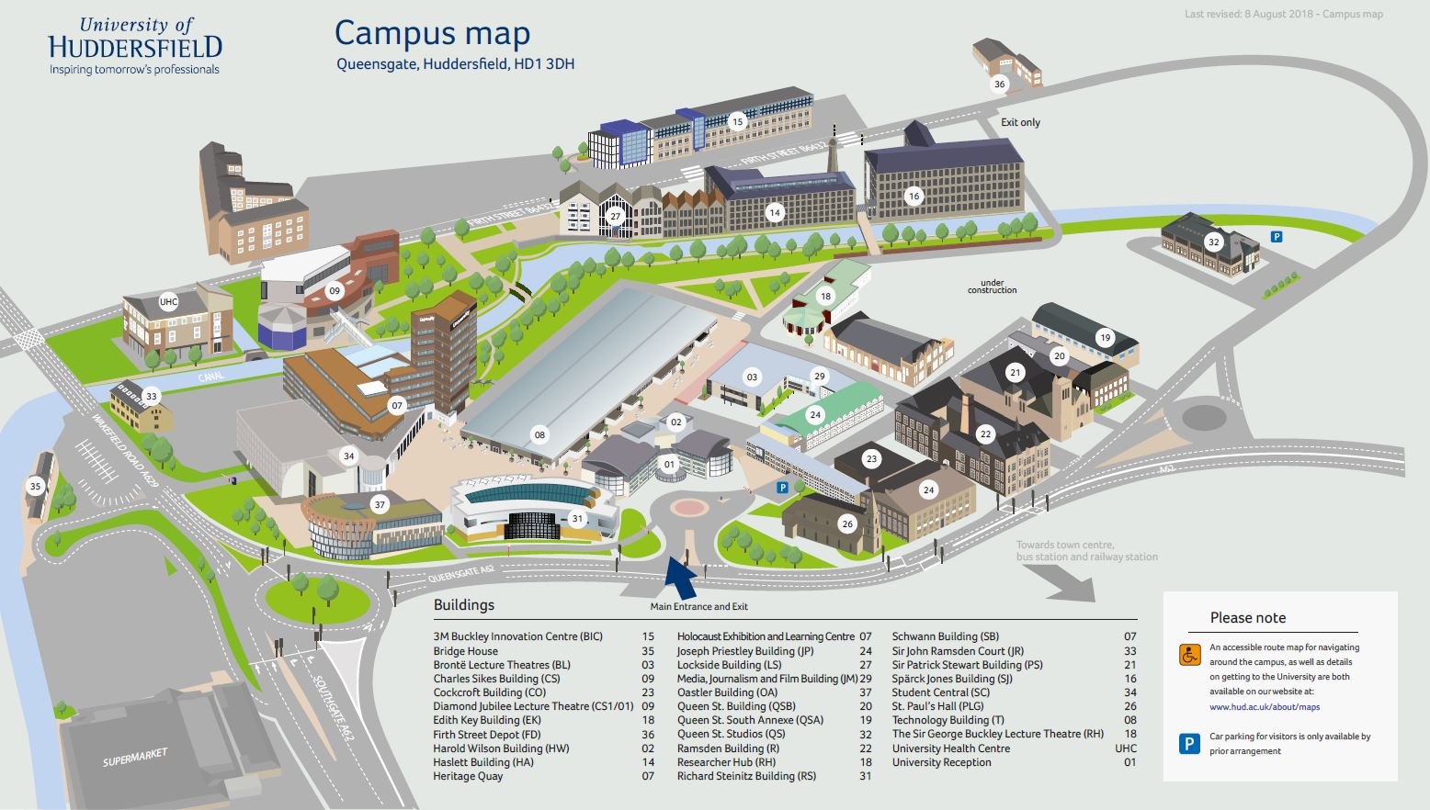
The Campus

Slide 12
Library

Slide 13
Huddersfield Business School

Slide 14
Why Huddersfield Business School ?
Working with Czech partners since 1991
faculty development
curriculum development
student exchange
staff exchange
500 Czech students since May 2004

Slide 15
Student Support
You will have a personal academic tutor (PAT) from the very first day at Huddersfield
The tutor will provide advice your studies in general and can provide some guidance about non-academic matters
The Business School has three Academic Skills Tutors, who are very helpful in relation to skills development and academic writing in English

Slide 16
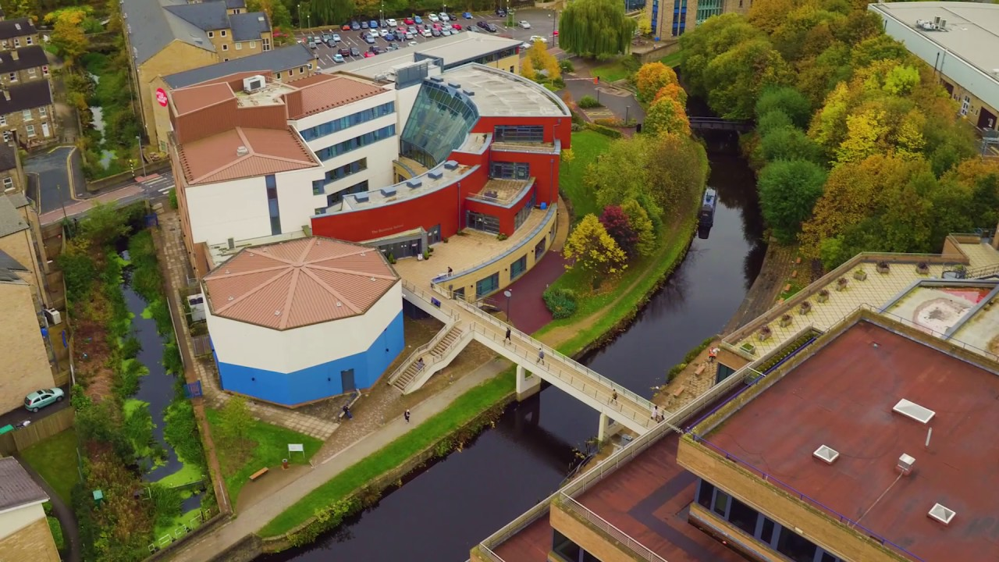
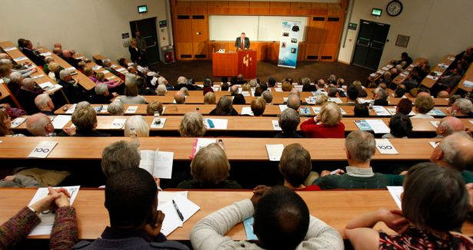
Huddersfield Business School

Slide 17
BA International Business (Year 3)
Course Structure
International Business: 10 ECTS
Strategic Management: 10 ECTS
Business Dissertation: 20 ECTS
and
two optional modules: 20 ECTS

Slide 18
The Business Dissertation
This is your largest single task (20/60 ECTS credits)!!
You choose a business topic and develop a research question
You investigate various methods of ‘original’ research (e.g. questionnaires, interviews) and you collect data by your chosen method(s)
The length of the dissertation should be normally 13-15,000 words
Regular meetings and/or e-mail contact with your Supervisor is essential

Slide 19
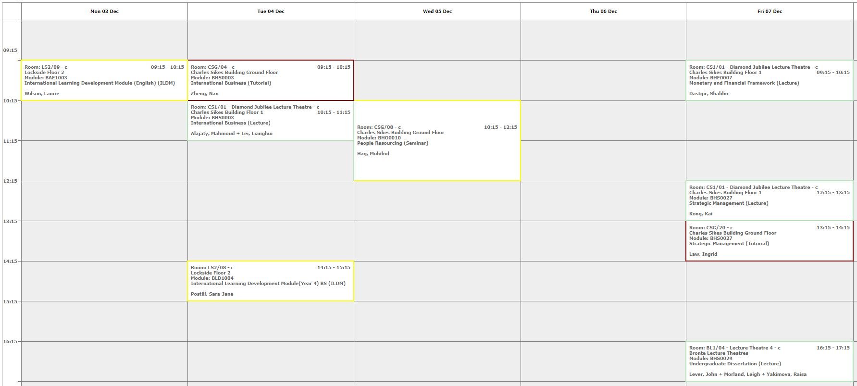
Academic Study
Only 10 hours per week in classroom but 30 hours per week in private study/library.

Slide 20
How do I apply ?
Apply through UCAS
Do not apply direct as you will not be eligible for government support (fee loans and grants)
There is a small fee (£11) for applying through UCAS
The UCAS number of this programme is N124 (Year 3 Entry Point)
If you have any questions please feel free to contact our International Office
For further information, please contact
Prof John R Anchor PhD
Associate Dean (International)
j.r.anchor@hud.ac.uk

Slide 21
Tuition Fees
There are no ‘up front’ fees – only graduate contributions
However students are required to take out a loan of £9,250 which is repayable after graduation
Please note that to qualify for the student loan you must not have more than 120 ECTS of Bachelor study

Slide 22
Financial Support
Czech Government & Your Faculty
As a result of the agreement signed between our two universities, you may be able to obtain further financial support of up to KČ 10,000 per month
Bank of Mum and Dad
Your family may be able to help you
Student Loan
You are eligible to apply for a student loan covering the tuition fee in full

Slide 23
Student Loan Repayment
Repayment will start once a student graduates and is earning enough per annum, starting in the April after graduation
Repayment levels rise with earnings – graduates pay back 9% of anything earned over £25000 (in the UK)
In the Czech Republic this figure is £16,800 per annum (40,000Kc per month)
Deducted automatically from salary through the tax system
If income falls below £25,000, repayments will be suspended
As an example, if graduates earn £25,000, they will repay their loan at the rate of just £1 per day
Repayment is based on what graduates can afford, not on the total amount borrowed
All outstanding repayments will be written off after 30 years

Slide 24
Salary Structure with Loan Repayments

Slide 25
MSc International Business Management
Course Structure
Strategic Management: 7.5 ECTS
International Economics: 7.5 ECTS
International Business Environment: 7.5 ECTS
International Business Strategy: 7.5 ECTS
Corporate Governance & Business Ethics: 7.5 ECTS
Research Methods & Techniques: 7.5 ECTS
and
two optional modules: 15 ECTS

Slide 26
MSc Business Economics
Course Structure
Macroeconomics: 7.5 ECTS
Microeconomics: 7.5 ECTS
Economic Statistics: 7.5 ECTS
Econometrics: 7.5 ECTS
International Economics: 7.5 ECTS
Strategic Management: 7.5 ECTS
International Business Environment: 7.5 ECTS
and
one optional module: 7.5 ECTS

Slide 27
Optional Modules
Functional Areas
e.g. International Marketing, International Human Resource Management, International Trade Operations, International Business Finance
Sectoral Areas
e.g. International Tourism Management and Development, Emerging and Alternative Financial Markets, Globalisation and Financial Crises

Slide 28
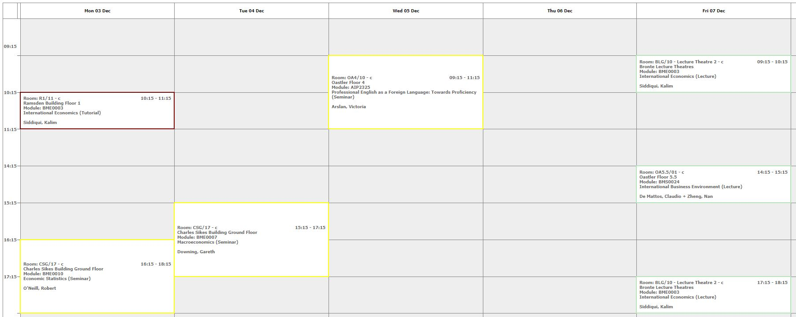
Terms 1 & 2: September - May
Only 10 hours per week in classroom but 30 hours per week in private study/library.

Slide 29
Semester 3: May - September
Dissertation and Postgraduate Research Paper (30ECTS)
These modules entail conceptualising, designing and conducting a piece of research using methods appropriate to your field of study.
You will select a research topic which corresponds to your own particular interests and develop a more specialised knowledge and understanding of this area.
The length of the Dissertation should be normally 15-20,000 words
The Research Paper is about 7000 words
Consultancy Project (30ECTS)
This module involves undertaking a practical project for a company and writing it up in the form of a report.

Slide 30
How do I apply ?
You can apply and join our 100 other nationalities in the Business School at:
http://www.hud.ac.uk/international/apply/
For further information, please contact
Prof John R Anchor PhD
Associate Dean (International)
j.r.anchor@hud.ac.uk

Slide 31
Tuition Fees
The fee for the whole programme (3 semesters) is £6,500
The Huddersfield fee is lower than that of any other university in the top half of the ‘Times’ league table

Slide 32
Financial Support
Czech Government & Your Faculty
As a result of the agreement signed between our two universities, you may be able to obtain further financial support of up to KČ 10,000 per month
Bank of Mum and Dad
Your family may be able to help you
Postgraduate Student Loan
As an EU national, you are eligible to apply for a postgraduate student loan

Slide 33
Postgraduate Student Loan
If you are an EU national, but don’t normally live in England, you may be able to get a Postgraduate Loan for a Master’s course in England
You can apply for a loan of up to £10,000 as a contribution towards your course and living costs
You repay only if earning more than £21,000 per year or £1,750 per month … not before April 2020
Find out more at www.gov.uk/studentfinancesteps

Slide 34
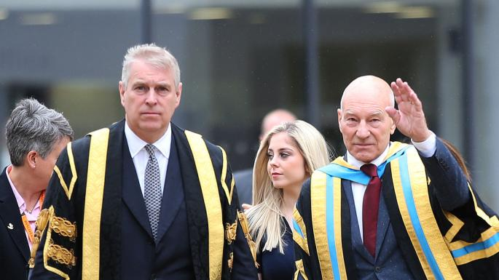
Academic Calendar 2019/20

Slide 35
Arriving and Living in Huddersfield

Slide 36
Living Costs
Housing and transport is more expensive in England
Clothing and houseware is more expensive in ČR
Food is about the same
Beer is more expensive in England … and not so good!

Slide 37
Accommodation
There are various sites offered by private companies but we advise you to stay at the University accommodation (DIGS).
Cost of DIGS
Ashenhurst £70 per week
Storthes Hall £85 per week
After sending your application to the University, you will receive Joining Instructions which will be sent to you automatically and will include accommodation options.

Slide 38
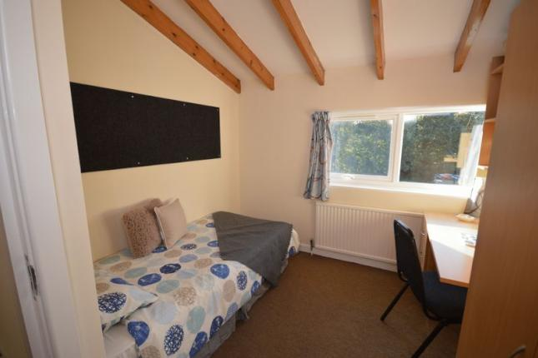
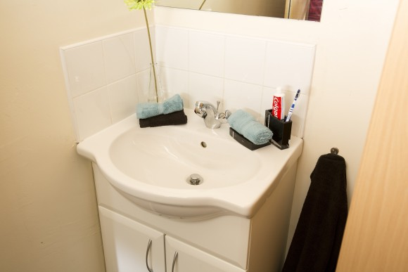
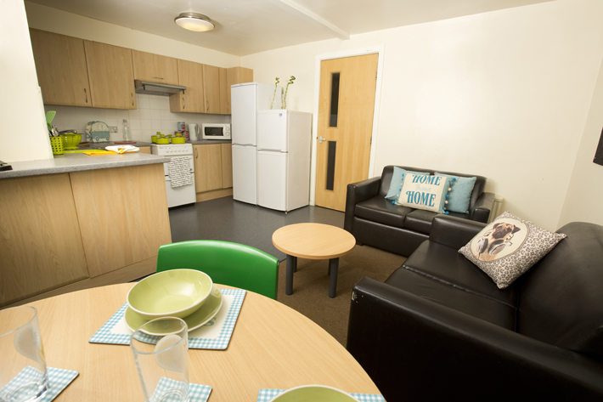
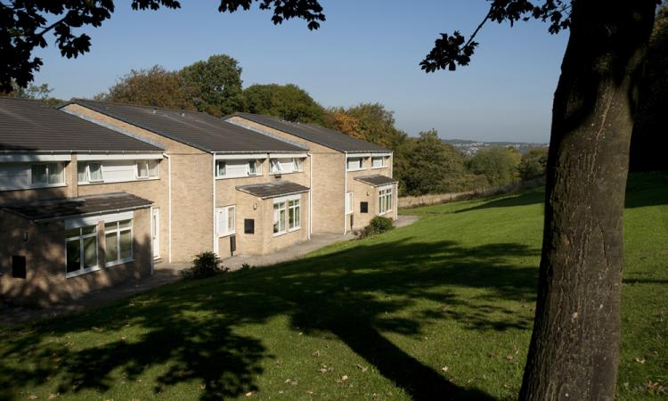
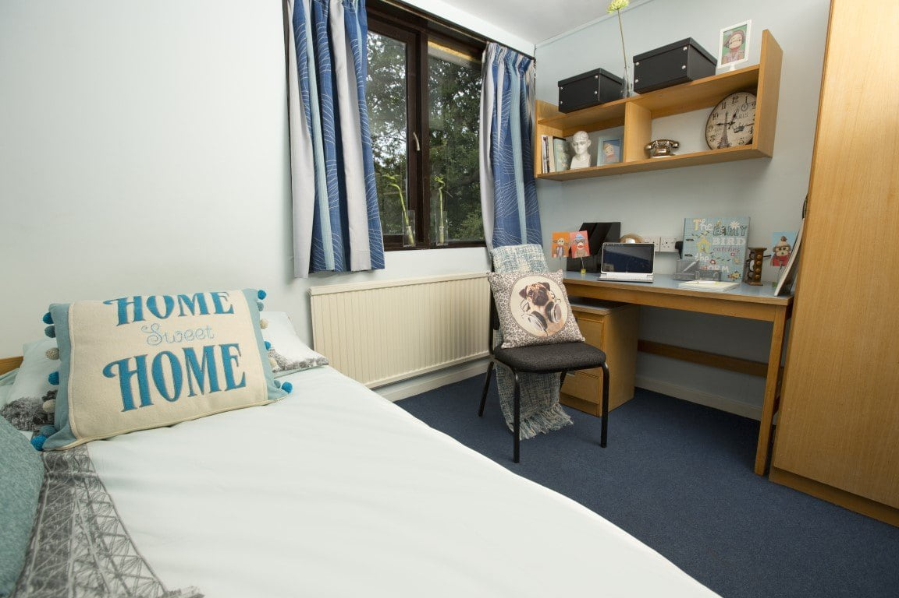
DIGS (koleje) Ashenhurst

Slide 39
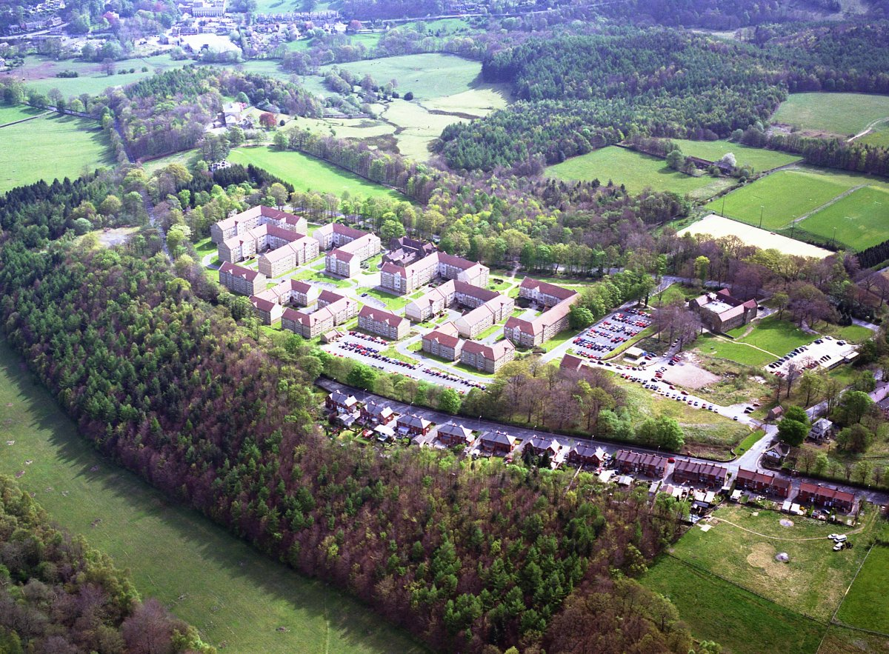
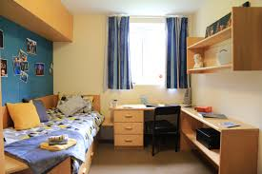
DIGS Storthes Hall Park
DIGS Storthes Hall

Slide 40
Employment
UK minimum wage per hour from April 2019 is £7.70 ( aged 21-24) and £8.21 (aged 25+)
Working for 15 hours per week is the University maximum
The University job shop advertises part time jobs and pays a living wage which is higher than the national minimum wage
There is usually plenty of bar and restaurant work
Administrative jobs and factories are another possibility

Slide 41
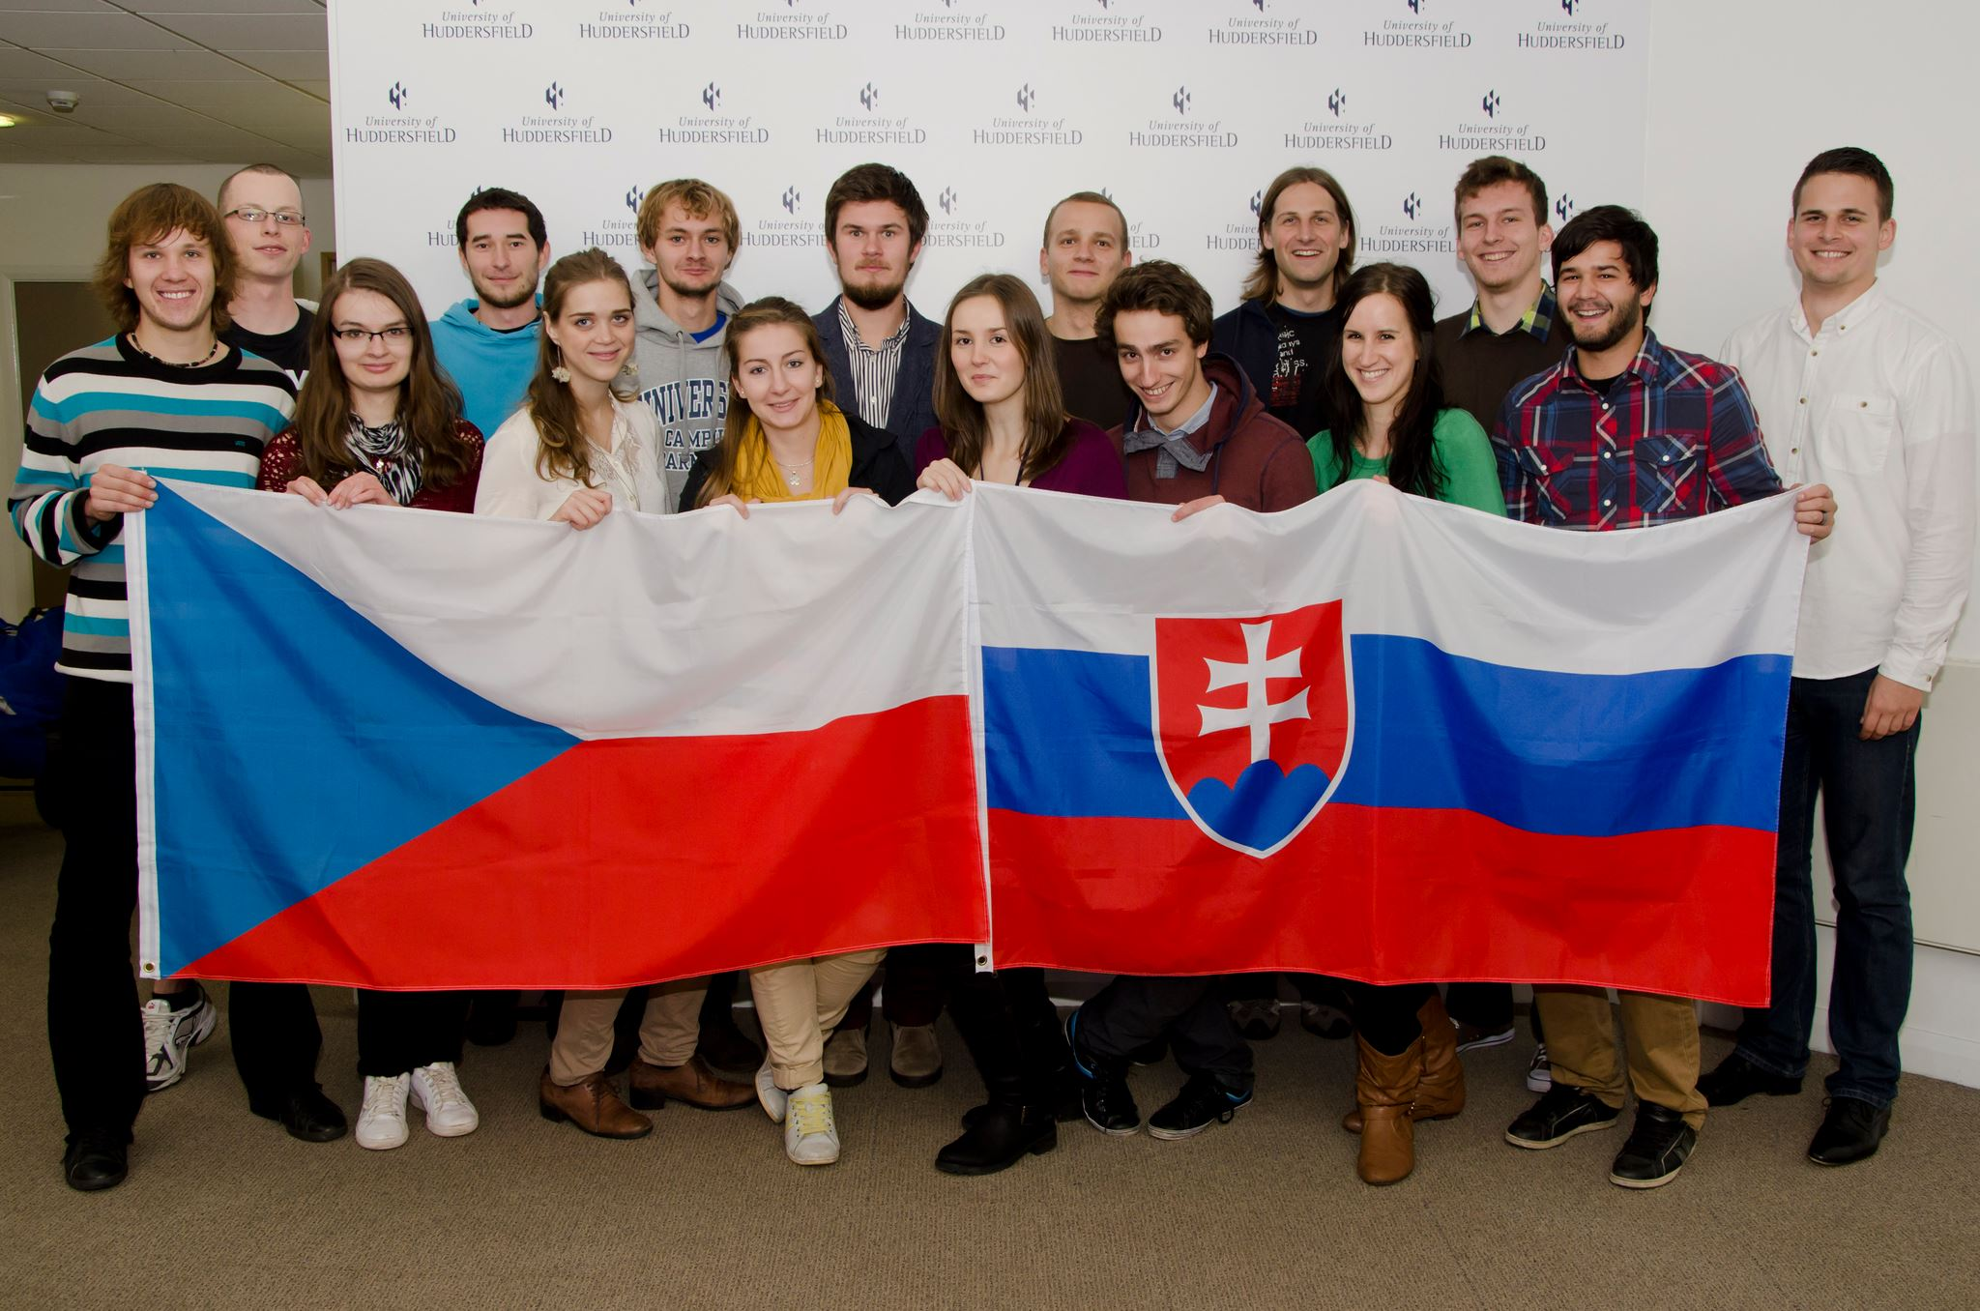
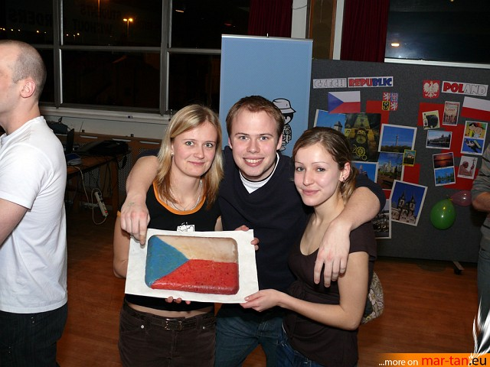
Peer Support
The best way to find your way around is from someone who has been in your shoes … previous Czech students have established a Czech and Slovak Student Society which participates in various cultural campus events and organises regular get-togethers for its members
https://www.facebook.com/czechoslovakhudsoc

Slide 42
Arrival
1 August 2019 is the earliest date to get housing
It is recommended to come to Huddersfield by 1 September 2019 if possible
It is recommended that you arrive earlier than 1 September if possible in order to get the best jobs - if you want one!
Important Dates
09 September 2019/06 January 2020 - Welcome Week
16 September 2019/06 January 2020 - Induction Week
23 September 2019/13 January 2020 - Start of Teaching

Slide 43
ANY QUESTIONS? Contact Hana - Personal Tutor h.benesova@hud.ac.uk John - Associate Dean (International) j.r.anchor@hud.ac.uk

